Slide 1
Youth and Transitional Youth – Medical Concerns
Screening/testing:
Recognize ACEs
STIs if sexually active
Screening for intimate partner violence
Treatment:
Trauma informed care
Can be difficult if not an emancipated minor
General exceptions
Preventative care:
Childhood vaccines
Meningitis vaccine
Gardasil vaccine
Birth control

Slide 2
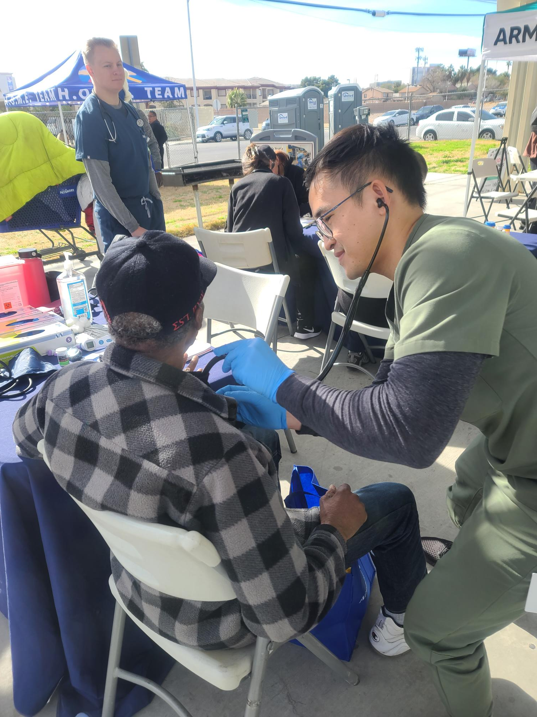
Seniors - Statistics
More likely to have chronic disease
Less resilient in recovery
Less able to tolerate heat
May be unable to afford co-pays for appointments or meds
Free Medicare only covers hospitalizations (may be eligible for Medicaid with Medicare but the system is complex)
Frequently need medical transitional housing

Slide 3
Seniors – Diabetes
Kidney disease
Regular screening is needed
Most common cause of kidney failure
Foot ulcers / amputations
Inspect feet daily
Wear socks and good shoes
Moisturize feet daily
Get sores treated immediately to avoid amputations
Loss of vision
Screening needed, sunglasses
50% more likely cataracts
Retina changes
Cardiovascular disease
Heart attacks / strokes
Heart disease #1 killer

Slide 4
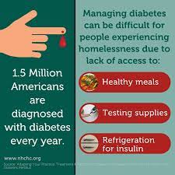
Diabetes
Polyuria, polydipsia, polyphagia
Tend to keep BG elevated
Current algorithm for treatment

Slide 5
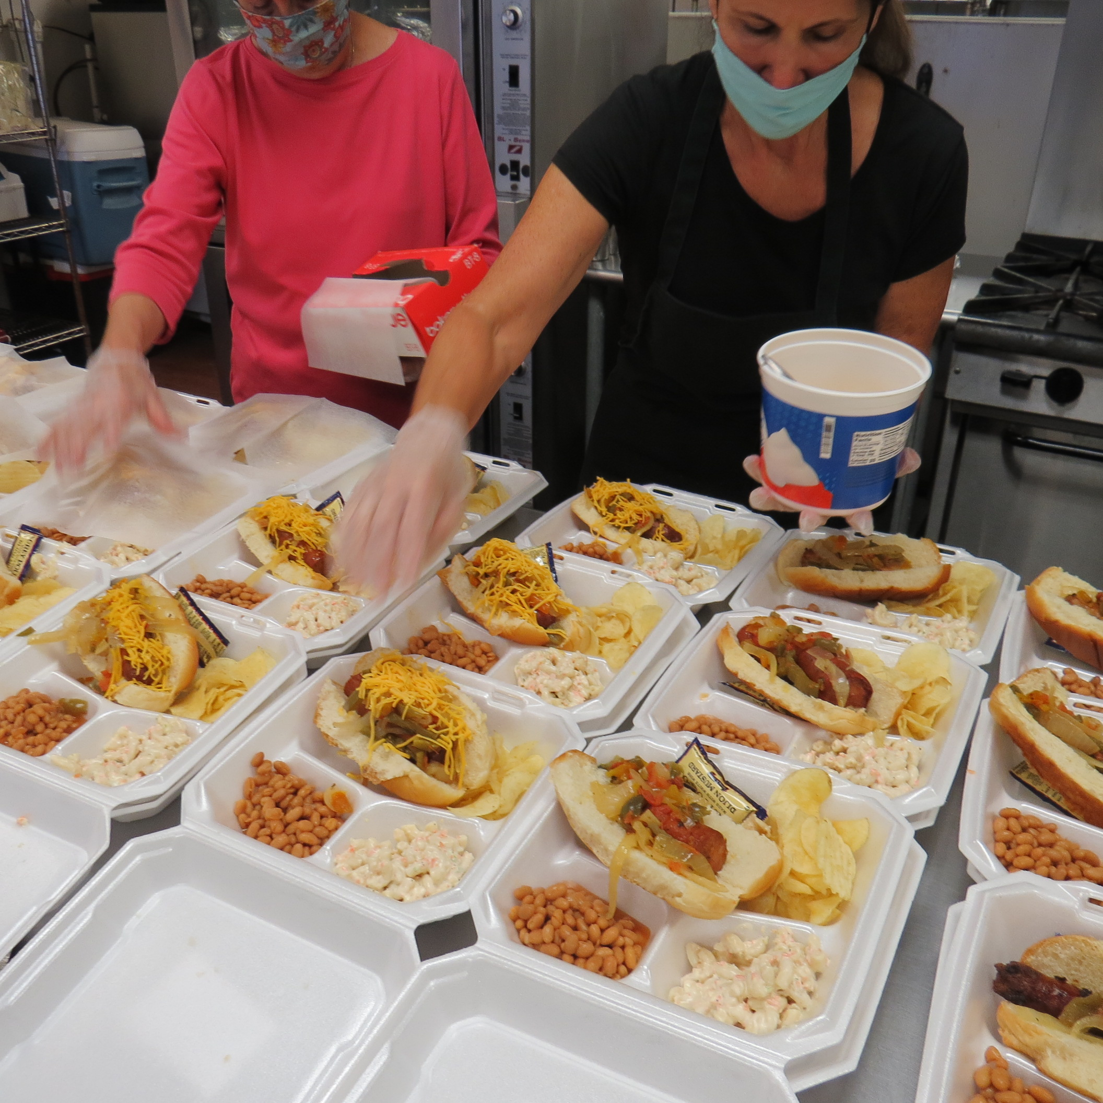
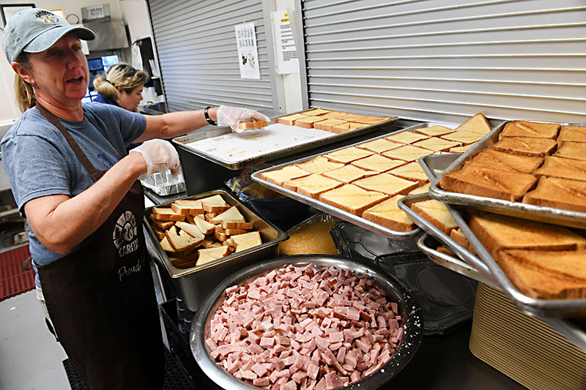
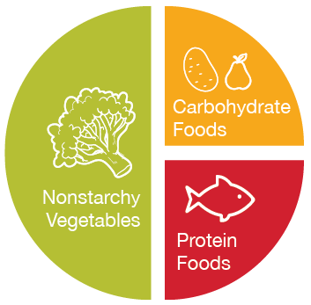
Diabetes – Food Insecurity

Slide 6
Seniors – Medical Concerns
Screening/testing:
Chronic health conditions – COPD, diabetes, hypertension, heart disease
Foot exams
Treatment:
COPD – inhalers, nebulizers
Medications for chronic conditions – pills, insulin
Preventative care:
Eye exams – wear sunglasses!
Harm reduction – tobacco cessation, obesity
Vaccines for seniors – pneumonia, high dose flu, COVID, shingles
Age-appropriate cancer screenings – lung (CT), mammograms, colon

Slide 7
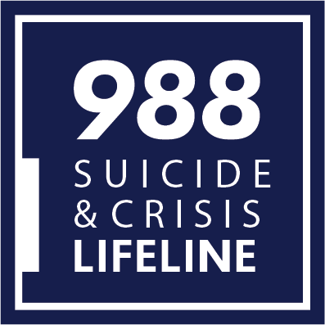
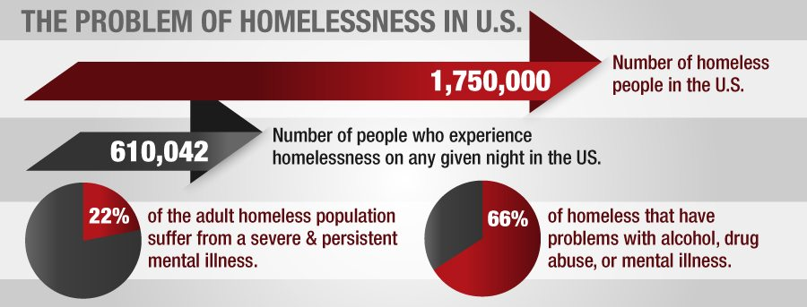
Serious Mental Illness (SMI)
SMI – schizophrenia, manic depressive, severe anxiety
May be quite ill without meeting the threshold for L2K
Frequently people with SMI self-medicate with alcohol/drugs (dual-diagnosis)

Slide 8
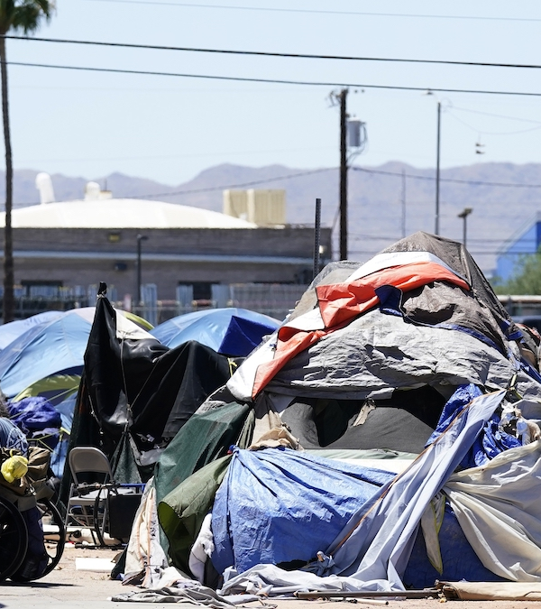
Serious Mental Illness (SMI) – Medical Concerns
Screening/testing:
Depression / suicidal ideation
Evaluation by a psychiatric practitioner
Treatment:
Need a mental health home / integrated care
Medication management – injections, fewer barriers
Autonomy allows for bad decisions
Medical conditions
Preventative care:
Treatment before a crisis

Slide 9
Substance Use Disorder (SUD) - Statistics
Over 1/3 of PEH have current alcohol or drug use
National Institute on Drug Abuse – 40% of those with SUD also have a mental health condition (dual diagnosis)

Slide 10
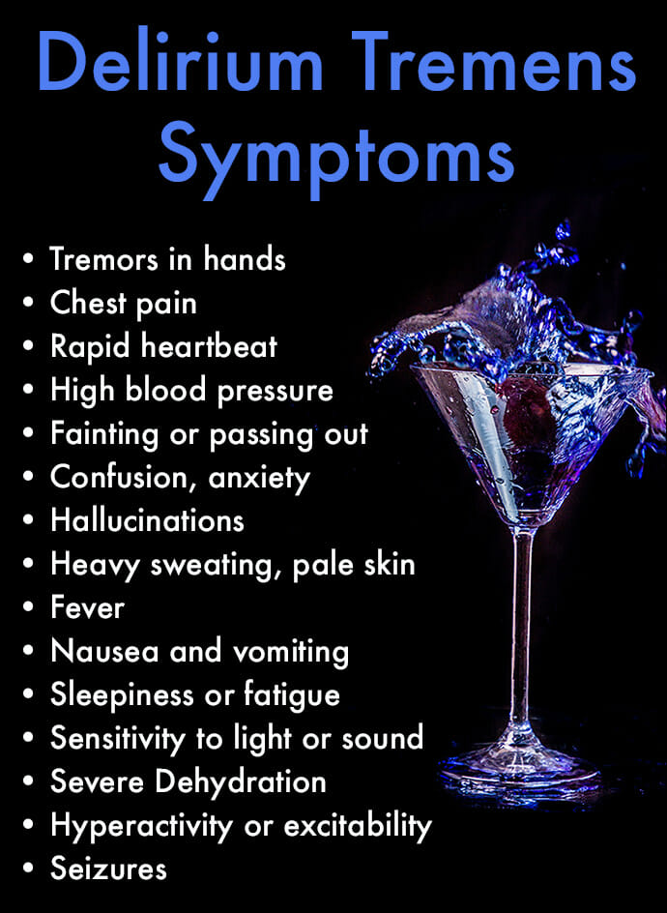
Alcohol Use Disorder (AUD) – Alcohol Cessation
Withdrawal begins 10-12 hours after last drink
Delirium Tremens begin 24-48 hours
Untreated DTs can result in seizures, aspiration pneumonia, delirium, and death
5-15% mortality rate if untreated
Requires in-patient treatment
Benzos – abrupt withdrawal is dangerous, similar treatment to avoid seizures and death

Slide 11
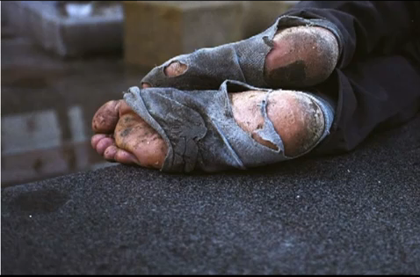
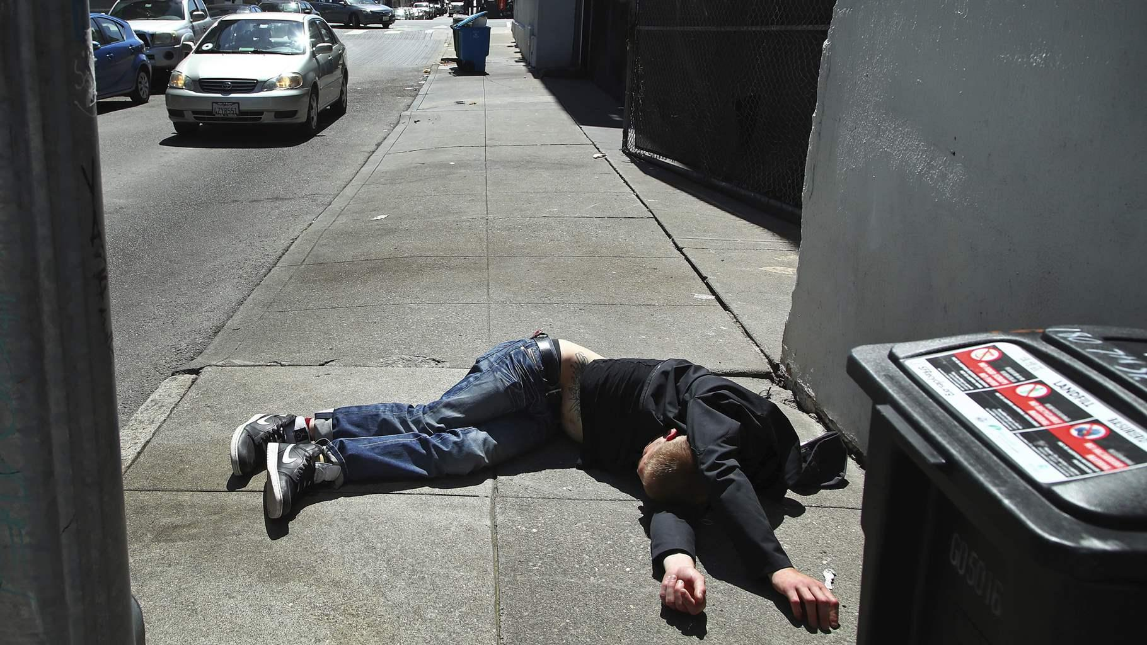
Substance Use Disorder - Heat

Slide 12
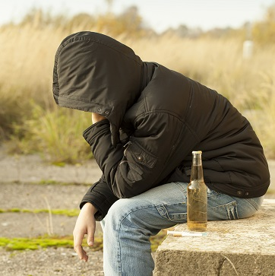
Substance Use Disorder (SUD) – Medical Concerns
Screening/testing:
HIV / Hep C screening (if injecting / sexual exposure)
Screening for other mental health conditions
Liver disease in those with significant alcohol use
Treatment:
Reduce barriers to care
Burns – wound care
Injectors – skin abscesses, wound care
In-patient rehab especially alcohol or benzo use
Preventative care:
Harm reduction – needles, PreP
Vaccines: Hep A, flu, COVID

Slide 13
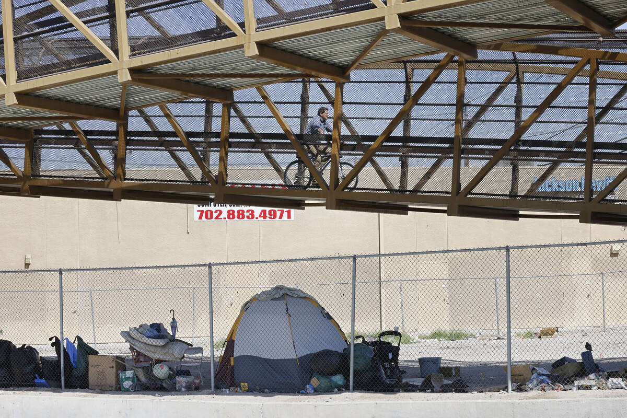
Immigrants - Statistics
Immigrants may not have childhood screening and vaccinations
Immigrants vs. refugees
May be unable to access resources due to immigration status
Often in dangerous conditions:
Work – no OSHA Exposure to chemicals, dangerous environments
Living – camps, housing conditions

Slide 14
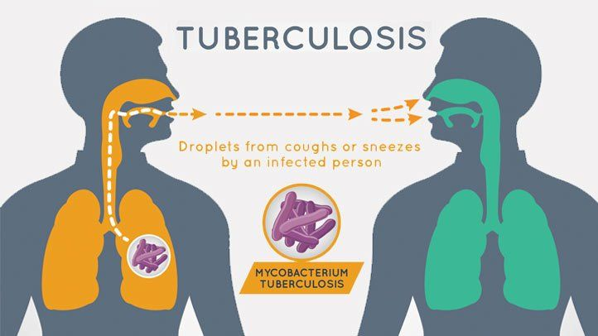
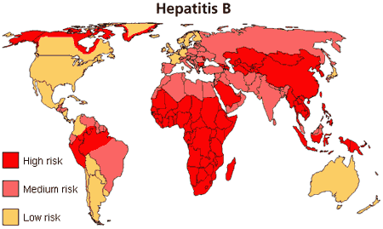
Immigrants – Medical Concerns
Tuberculosis – active vs. latent TB, 1:10 of latent become active
High in homeless populations
Even higher in immigrant populations from endemic countries
Hepatitis B – more likely to have CHB if from endemic countries
Central America, Asia, Africa, Middle East
Vertical transmission is common, and may not get vaccinated

Slide 15
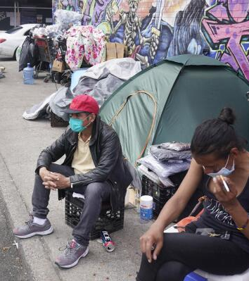
Immigrants – Medical Concerns
Screening/testing:
TB screening if available
Infectious disease
Treatment:
If uninsured, free resources to avoid hospitalization
In language assistance
Preventative care:
Vaccinations including Tetanus

Slide 16
Summary
Consider intersectionality in your approach to PEH
Medical care should be different in different populations
Trauma informed care is important in all populations
Bring medical care to where people are
Promote preventative care in vulnerable people

Slide 17
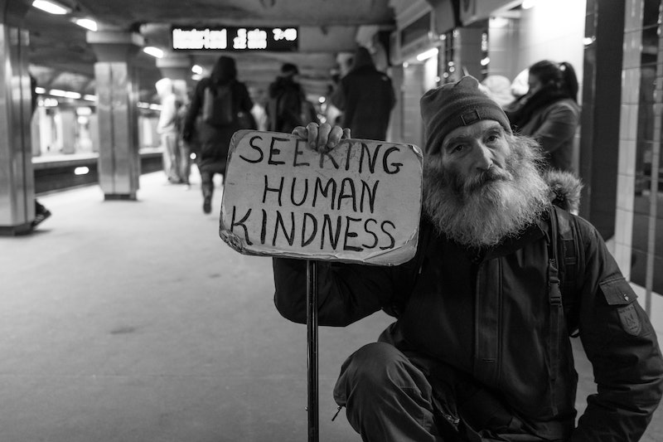

Slide 18
Case #1 – Woman in DV Shelter
25yo woman in with no PMH complains of GERD symptoms and insomnia. What medical considerations are there?
Screening:
Treatment:
Prevention:

Slide 19
Case #1 – Woman in DV Shelter
25yo woman in with no PMH complains of GERD symptoms and insomnia. What medical considerations are there?
Screening:
Screen for depression, anxiety, PTSD
Screen for trafficking
Offer STI
Treatment:
GERD – avoid triggers, medications
Insomnia – sleep hygiene, treat the underlying condition
Prevention:
Offer PreP and birth control

Slide 20
Case #2 – Senior Unsheltered
66yo man with PMH DM, HTN presents today for “screening”. Blood pressure 178/90 “that’s normal for me” and BG 367 “I just drank a Gatorade). What medical considerations are there?
Screening:
Treatment:
Prevention:

Slide 21
Case #2 – Senior Unsheltered
66yo man with PMH DM, HTN presents today for “screening”. Blood pressure 178/90 “that’s normal for me” and BG 367 “I just drank a Gatorade). What medical considerations are there?
Screening:
Ask about vision, check feet, ask about chest pain / SOB
Treatment:
BP and BG are elevated, discuss treatment goals, offer to adjust meds
Refer to easily accessible medical clinic for labs
Prevention:
Discuss diet (avoid juice, soda, Gatorade)
Offer vaccines (COVID, high dose flu, pneumonia, shingles, etc.)
Harm reduction (tobacco cessation, good shoes/socks)

Slide 22
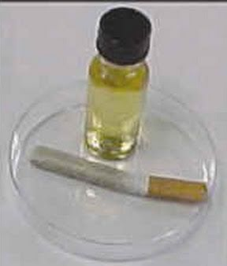
Case #3 - SUD / SMI
35yo man sleeping at The Courtyard (unsheltered) has sores on his calf. He admits to smoking “sherm sticks” in order to avoid hearing the voices. What medical considerations are there?
Screening:
Treatment:
Prevention:

Slide 23
Case #3 - SUD / SMI
35yo man sleeping at The Courtyard (unsheltered) has sores on his calf. He admits to smoking “sherm sticks” in order to avoid hearing the voices. What medical considerations are there?
Screening:
Voices – could be SMI or result of substances
Screen for SI / HI
Ask about sores – rest of body, IVDU?
Treatment:
Assess readiness for help
Prevention:
Very likely to experience a crisis without desire to get better and a medical mental health home

Slide 24
Case #4 – Immigrant from Columbia
35yo male, undocumented immigrant from Columbia x 2 months, experiencing homelessness. Was being treated in Columbia for HIV. What medical considerations are there?
Screening:
Treatment:
Prevention:

Slide 25
Case #4 – Immigrant from Columbia
35yo male, undocumented immigrant from Columbia x 2 months, experiencing homelessness. Was being treated in Columbia for HIV. What medical considerations are there?
Screening:
In-language counseling
Offer screening for other STIs / Hep B/C / TB
Depression / SI
Treatment:
Refer directly to a treatment center, then and there
Prevention:
PreP, risk reduction

Slide 26
Case #5 – Woman with SOB
30yo woman with history of multiple food allergies presents in The Courtyard with significant SOB. Leaning forward, appears distressed, spitting out saliva on the pavement, appears to be in distress. What medical considerations are there?
Screening:
Treatment:
Prevention:

Slide 27
Case #5 – Woman with SOB
30yo AA woman with history of multiple food allergies presents in The Courtyard with significant SOB. Leaning forward, appears distressed, spitting out saliva on the pavement, appears to be in distress. What medical considerations are there?
Screening:
Read the room – this isn’t the time and place
Treatment:
Urgently needs medical intervention
Prevention:
Don’t leave the hospital without an Epi pen script

Slide 28
Contact Information
Rebecca Edgeworth, MD
redgewor@touro.edu
Mayra Gonzalez, CHW
mgonzale34@touro.edu
Touro University Nevada
https://tun.touro.edu/

Slide 29
References
https://endhomelessness.org/homelessness-in-america/homelessness-statistics/state-of-homelessness/
https://www.americashealthrankings.org/explore/measures/PCP_NPPES
https://endhomelessness.org/blog/recognizing-women-experiencing-homelessness-a-womens-history-month-spotlight-on-downtown-womens-center/
https://www.ncbi.nlm.nih.gov/pmc/articles/PMC4833089/
Adverse Childhood Experiences (ACEs) | VitalSigns | CDC

