Slide 1
Realizing Equity through Data and Action
2023 Nevada Statewide Conference

Slide 2
Welcome!
Ashley Barker Tolman
She/Her
White
Alissa Parrish
She/Her
Asian

Slide 3
What brought you to this session?

Slide 4
Agenda
01
02
03
APR/CAPER
Stella P
Action
What is it and what can it do for us?
How can we use this to inform our work?
What can I do in the next week to take action?

Slide 5
What are the APRs/CAPERs and what do they tell us about our project performance and disparities that exist within?
APR/CAPER

Slide 6
The Continuum of Care (CoC) Annual Performance Report (APR) and Emergency Solutions Grants (ESG) Consolidated Annual Performance and Evaluation Report (CAPER) are project-level reports that are available in HMIS to be run on any project in the system.
https://www.hudexchange.info/resource/4696/hmis-programming-specifications/

Slide 7
What?
Required for specific funding streams
Aggregate-level reporting
Performance-related metrics
Data quality metrics
Align with the most recent HUD data standards

Slide 8
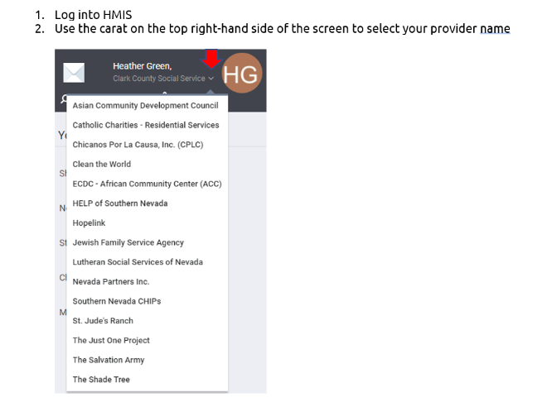
How?

Slide 9
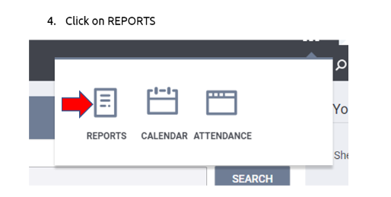
How?

Slide 10
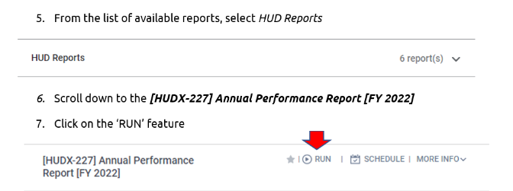
How?

Slide 11
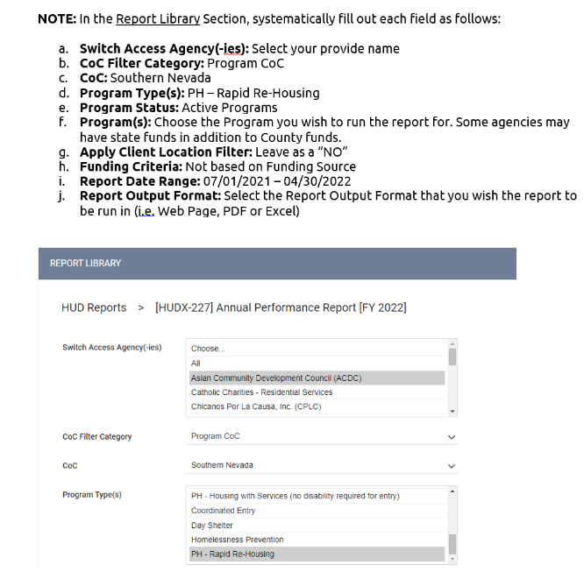
How?

Slide 12
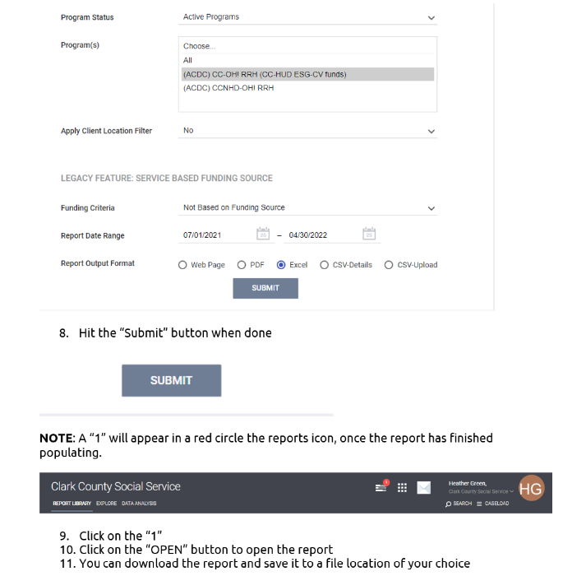
How?

Slide 13
Improvements
For FY2024, HUD worked with the Data Lab and Sage to add questions to the reports that intentionally incorporate equity and assist communities in beginning to understand disparities that exist within projects. New questions included were in response to three HUD priorities:
Tracking newly measurable outputs/outcomes resulting from Data Standards changes
Equity-based measures across housing attainment and outcomes
Assessing efficacy of move-on strategies across available subsidy types

Slide 14
New Questions
Question # | Title
Q22f | Length of Time Between Project Start Date and Housing Move-In Date by Race and Ethnicity
Q22g | Length of Time Prior to Housing by Race and Ethnicity – Based on 3.917 Date Homelessness Started
Q23d | Exit Destination – Subsidy Type of Persons Exiting to Rental by Client With an Ongoing Subsidy
Q23e | Exit Destination Type by Race and Ethnicity

Slide 15
New Questions
Question # | Title
Q24b | Moving On Assistance Provided to Households in PSH
Q24c | Sexual Orientation of Adults in PSH
Q24d | Language of Persons Requiring Translation Assistance
Q25j | Exit Destination – Subsidy Type of Persons Exiting to Rental by Client With an Ongoing Subsidy – Veteran
Q27f2 | Exit Destination – Subsidy Type of Persons Exiting to Rental by Client With an Ongoing Subsidy – Youth
Q27m | Education Status - Youth

Slide 16
What is Stella P and what does she tell us about our system performance and the disparities that exist within?
Stella P

Slide 17
Stella P(erformance)
Definition
Stella P is a data visualization of the Longitudinal Systems Analysis (LSA) dataset to help communities understand how their homeless response system has been performing on critical performance measures.
https://www.hudexchange.info/homelessness-assistance/stella-and-system-modeling/
Notes:
https://www.ferris.edu/administration/president/DiversityOffice/Definitions.htm

Slide 18
Projects Included in Stella P and Other Information
Projects included in Stella P
Emergency Shelter (ES)
Safe Haven (SH)
Transitional Housing (TH)
Rapid Rehousing (RRH)
Permanent Supportive Housing (PSH)
Other Permanent Housing (OPH)
Based on data from HMIS
LSA is an export from HMIS
Reporting period is 10.1 - 9.30 of each fiscal year
Can locally Stellavise data for any time period
Reports data by households, not individuals
This is distinctly different from the System Performance Measures (SPMs)
Disaggregates data by race/ethnicity as well as specific household types
Includes demographic information
Also includes comparisons of demographics by project type

Slide 19
"Big 3" Performance Measures
Length of time experiencing homelessness
Average length of time
Includes a toggle to include 3.917 data
Exits to permanent destinations
Includes data on other exits (temporary and unknown)
Returns to homelessness
Includes returns within 6, 12, and 24 months after exiting the system
Requires a lookback period that includes prior exits from the system

Slide 20
System Performance
System Map
Not Project-Level
Shows how households flow through the system
Projects feed into the system, measures are at the system level
System Engagement
Baseline System-Level Information
Includes counts of households experiencing homelessness for the first time
Great tool to begin to understand system performance and disparities

Slide 21
Let's Take a Look!
NV-500: Las Vegas/Clark County CoC
NV-501: Reno/Sparks/Washoe County CoC
NV-502: Nevada Balance of State CoC

Slide 22
What action(s) can I take in the next week to incorporate an equitable approach to the way I show up?
Action

Slide 23
How Might We?
Internally
Interpersonally
Institutionally
Structurally
Learn about your own implicit biases
Identify where your implicit biases show up within your interactions and relationships
Discuss a policy or procedure within your workplace that is problematic
When you see something, say something; vote; don’t support businesses that are racist

Slide 24
Internally
1
2
3
Implicit Bias
Do you know what yours are?
Do Your Own Research
What do you need to learn about?
Power You Hold
What power do you hold and how do you use it?

Slide 25
Interpersonally
Implicit Bias in Action
Who Surrounds You
Intent vs. Impact
How have your implicit biases showed up?
What steps can you take to decrease your implicit biases?
Who do you spend your time with?
What beliefs and values do those around you hold?
Do you know both your intentions and your impact?

Slide 26
Institutionally
What policies exist within your place of work that are problematic?
What influence might you have to change problematic policies and practices?

Slide 27
Structurally
Being actively anti-racist is difficult. It means being willing to speak up. It means being uncomfortable. It means leveraging the power you hold to support and lift up those without power.
How do you spend your time?
Where do you spend your money?
What causes do you support?

Slide 28
Questions

Slide 29
Thank You!
Ashley Barker Tolman
Alissa Parrish
Ashley.barkertolman@gmail.com
Alissa.parrish@icf.com

