Slide 1
Rural Nevada Continuum of Care
Overview, service delivery, and challenges

Slide 2
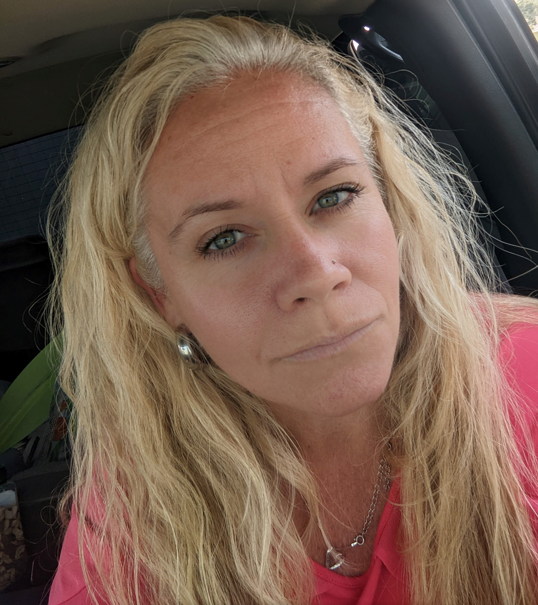
Jackee Stewart, Essential Services Supervisor
Churchill County Social Services
(775)426-8482 jackee.stewart@churchillcountynv.gov

Slide 3
Introduction – Who are the Rural Continuum of Care
The RNCoC is a collaborative and inclusive community-based process for planning and managing homeless assistance resources and services effectively and efficiently to end homelessness in the 15 rural counties that make up the RNCoC.
The purpose of the RNCoC is to assist through planning, education, and advocacy in the coordination, development, and evaluation of services and housing for individuals experiencing or at risk of experiencing homelessness. The RNCoC’s mission is to mobilize and coordinate resources to improve the lives of people at risk of or experiencing homelessness in rural Nevada.

Slide 4
Membership
Participation is open to anyone who wishes to help communities address and end homelessness;
Steering Committee is comprised by at a minimum shall be comprised of federal, state and local governments; non- profit homeless providers; faith-based organizations; youth organizations; and treatment providers.
Sub-Committee members are comprised of different Steering Committee members.

Slide 5
Coordinated Entry
The coordinated entry system (CES) coordinates access, assessment, prioritization, and referral for housing and supports for people experiencing or at-risk for homelessness in a community.
Access: Goal is to have a designated access point in each county to conduct initial intake and assessment.
Assessment: to conduct the CHAT (Community Housing Assessment Tool) that is person centered, culturally and linguistically appropriate
Prioritization: based on acuity, chronicity, time homeless and time on community queue
Referral: housing provider notifies the matchmaker of vacancy then the matchmaker refers participants to the provider based on prioritization

Slide 6
Match Maker – Process and Challenges
Housing provider notifies the matchmaker of vacancy then the matchmaker refers participants to the provider based on prioritization, all completed through our data system, HMIS
Challenges:
Our homeless population is very transit, often participants go from rural into urban and back
Being able to locate participants once the provider receives a referral from the match maker

Slide 7
Point In Time Count - PIT
The Point-in-Time (PIT) count is a U.S. Department of Housing and Urban Development (HUD) mandated count of sheltered and unsheltered people experiencing homelessness. The count is traditionally conducted on a specific night (i.e., a single “point in time”) during the last two weeks in January in order to minimize duplicated counts and give a more accurate picture of homelessness in Nevada.
The PIT is conducted to:
→ Measure and monitor trends and changes in homelessness on local and national levels and track progress toward ending homelessness.
→ Help communities understand what resources are needed and strategize the best ways to use them to end homelessness

Slide 8
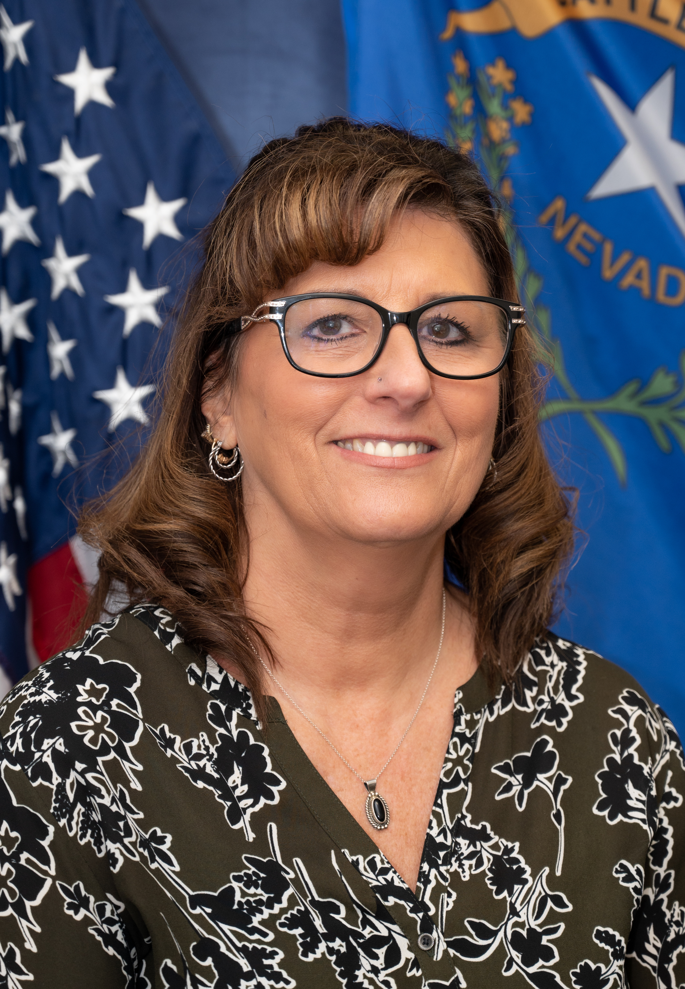
Karyn Smith, Director and Public Guardian
Nye County Social Services
(775)277-0075 ksmith@nyecountynv.gov

Slide 9
Service Delivery in Rural Nevada
Emergency Shelters, Transitional and Permanent Housing
Designated Access Points – Coordinated Entry System
Housing First Approach
Education and Training
Case Management
Healthcare, Mental and Substance Abuse Treatment

Slide 10
Challenges with Service Delivery in Rural Nevada
Housing Inventory and Availability
Affordable Housing
Landlords – Lack of Participation/Engagement
Chronic Substance Abuse
Psychological Barriers to Change (Comfort Zone)
Criminal Records – Felonies, Sexual Offenses
Capacity to Fully Case Manage

Slide 11
Funded Participants
2022
NV-502 - Nevada Balance of State CoC
CCHHS GLP $35,232 CoC
CCHHS GLP Expansion $22,165 CoC
High Desert Housing - Expansion $62,502 CoC
High Desert Housing - Vitality Center $24,448 CoC
HMIS Rural Nevada 2022 $92,741 CoC
Humboldt County Expansion Grant $51,370 CoC
Humboldt County Permanent Housing $32,181 CoC
Humboldt County Rapid Rehousing Project $40,803 CoC
NV-502 CoC Planning Grant 2022 $28,039 CoC
Nye County Rapid Rehousing Expansion 2023-2024 $31,355 CoC
Nye County Rapid Rehousing Renewal 2023-2024 $62,546 CoC
RRH7 $75,294 CoC
Shelter Plus Care FY2022 $164,004 CoC
SPC1 $56,312 CoC
Supportive Services Only - Coordinated Entry (SSO-CE) $39,629

Slide 12
Positives in the Rural Nevada Continuum of Care
Individuals and Families Housed
Stabilized Housing
Ongoing Case Management
Coordination and Partnerships with Community Members/Agencies
Connect to Multitude of Resources
Improve Health Outcomes

Slide 13
Shannon Ernst, Director and Public Guardian
Churchill County Social Services
775-427-0035 shannon.ernst@churchillcountynv.gov

Slide 14
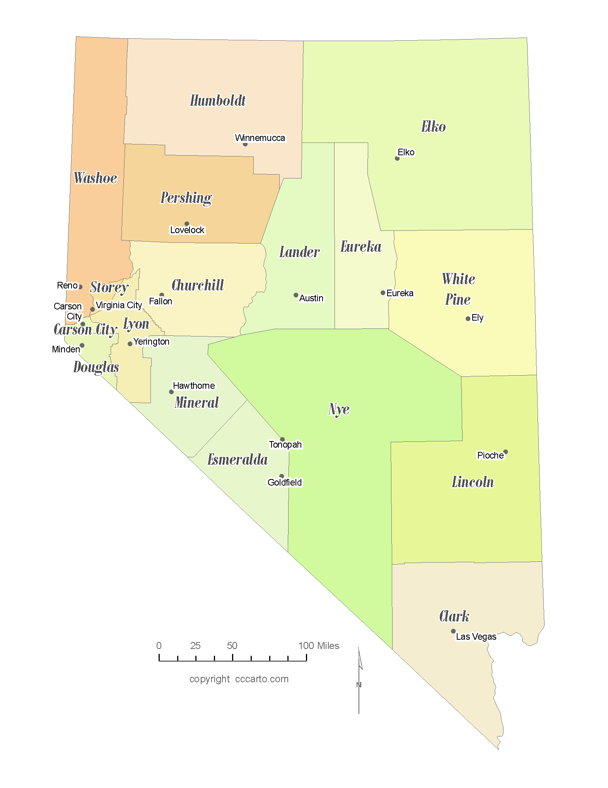
Challenges in the Rural Nevada Continuum of Care
15 of 17 Nevada Counites and 7 incorporated cities – Excludes Clark and Washoe Counties
Over 96,000 square miles in Nevada
Total population of 362,934

Slide 15
CoC Balance of State Funding HUD NV-502
Limited CoC allocations to serve 15 counties:
YEAR | # of New Projects | # Renewal Projects | Total Renewal Awards | Total New Awards | Total Funding
2005 | 1 | 3 *including HMIS | $489,819 | $101,580 | $591,399
2022 | 0 | 15 * including HMIS and Planning Grants | $818,621 | $0 | $818,621
17 year dollar award increase over 12 additional project |  |  |  |  | $227,222

Slide 16
Sustainability
CoC Oversight
Governance Committee
Contracted Facilitation – Funding State, HUD Planning Grant
Increased Cost of Facilitation to meet the needs of NV-502

Slide 17
Summary
RNCoC has opportunities to increase partnerships, but needs more counties to contribute to the process.
Coordinated Entry / Match Maker for all 15 counites builds access for all communities, but must have county and non-profit participation to sustain services and process.

Slide 18
Thank you
Questions?

