Slide 1
Painting a Clear Picture – the 5 C’s of Effective Communication
Michelle Johnston
Director of Behavioral Health
U.S.VETS – Las Vegas

Slide 2
Art Class Assignment
Create a picture of your job. You have 2 minutes.

Slide 3
Art Class Assignment
How confident are you that you completed the assignment the way I wanted it done?
Why or why not?
Set it aside – we’ll come back to it later

Slide 4
Getting Others to “Get It”
They don’t know what they don’t know
They haven’t mastered mind-reading
They don’t feel safe asking questions

Slide 5
What Challenge Do You Currently Face?
Someone’s work isn’t meeting standards
Someone isn’t bought into a change you are making/have made
You want to delegate something to someone
You want to implement a strategy to solve a problem
You aren’t receiving the support you need from someone

Slide 6
The 5 C’s of Communication
Color
Context
Connective Tissue
Cost
Consequence
Notes:
Credit to Brene Brown

Slide 7
Color
Paint the full picture
Set a clear intention
Assign a level of importance
Answer, “What does ‘done’ look like?”

Slide 8
Art Class Assignment
Color
Intention: Think about job from perspective of what you do, rather than job title
Importance: Moderate importance to illustrate the concepts today
Paint ‘done’: Using any medium, create a pictorial representation of your job responsibilities. You can draw, use shapes, color, apps on your phone or computer, or word art.

Slide 9
What is one more detail still you can add to make this full color?
Color
Context

Slide 10
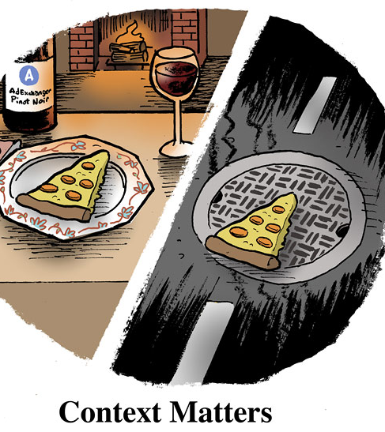
Context
Share the impact of this decision or assignment
Why is it important?
Who will it help?
Where and when should it be done?

Slide 11
Art Class Assignment
Context
Impact: By doing the assignment before and after learning the 5 C’s, the concepts will be reinforced.
Why? Thinking in pictures awakens another part of our brain and aids in memory.
Who, Where and When? At the end of the presentation, there will be time to do it again, using any medicum at your disposal so that you may share with the group if you desire.

Slide 12
What can you do if you don’t know the context yourself?
Color
Context
Connective Tissue

Slide 13
Connective Tissue
How does this task/decision solve or amplify what’s already happened or what’s happening now?
How does it lay the groundwork for the vision of the future?

Slide 14
Art Class Assignment
Connective Tissue
Past: Communication has been unclear, and employees got frustrated with each other
Present: Practicing communication through an assignment with little consequence
Future: When you must communicate a task, request or decision to another person, this activity will help you remember the 5 C’s.

Slide 15
What else can you share about the past, present and future that relates to your challenge?
Color
Context
Connective Tissue
Cost

Slide 16
Cost
Money
Time
Capacity
Priority level
Risk
Notes:
When you say “yes” to one thing, you are saying “no” to something else.

Slide 17
Art Class Assignment
Cost
Money: Free
Time: 1-3 minutes
Capacity: Offering time during presentation
Risk: Insecurity, pride
Priority level: Medium

Slide 18
Does the recipient of the message know what they will have to say “no” to in order to say “yes” to this? Who gets to decide what that is?
Color
Context
Connective Tissue
Cost
Consequence

Slide 19
Consequence
Not doing it
What is at stake?
Getting it wrong
Unintended consequences to anticipate and problem-solve

Slide 20
Art Class Assignment
Consequence
Not doing it: Miss out on the opportunity to reinforce the concepts
What’s at stake? Better understanding of one another’s duties and 5 C’s
Getting it wrong: Totally fine
Unintended consequences: embarrassment
Sharing is optional

Slide 21
How comfortable are you sharing the consequence? On following through?
Color
Context
Connective Tissue
Cost
Consequence

Slide 22
Art Class Assignment
Create a picture of your job on any medium available to you, using drawings, online pictures, shapes, word art or anything else creative.
You will have 2 minutes for this assignment, and sharing is optional.
When you are done, you may choose to share your image with the group.

Slide 23
Art Class Assignment
Compare your two assignments and the communication.
What gets in the way of providing the 5 C’s?
What gets in your way of asking for the 5 C’s when they would increase your ability to deliver?

Slide 24
Reflection
What gets in the way of providing the 5 C’s?
What gets in your way of asking for the 5 C’s when they would increase your ability to deliver?

Slide 25
Clear is kind. Unclear is unkind.
Sometimes speaking the truth feels like we are being unkind, especially when sharing difficult information or feedback. But in reality, dancing around the truth is unkind. When we avoid stating the truth – when we are vague or ambiguous under the guise of being kind – it is often because we are trying to lessen the discomfort for ourselves, not for the other person.
~Brené Brown, Dare to Lead

Slide 26
What was most valuable for you today?

