Slide 1
Medical Care of Special
Populations withing People
Experiencing Homelessness
Rebecca Edgeworth, MD
Mayra Gonzalez, CHW
August 15, 2023
NHA Ending Homelessness Symposium, Reno, NV

Slide 2
Objectives
How university-based medical care benefits the students, university and the community
Understand the importance of considering intersectionality
Recognize special populations within people experiencing homelessness (PEH)
Understand important medical considerations within populations
Preventative Care for PEH populations

Slide 3
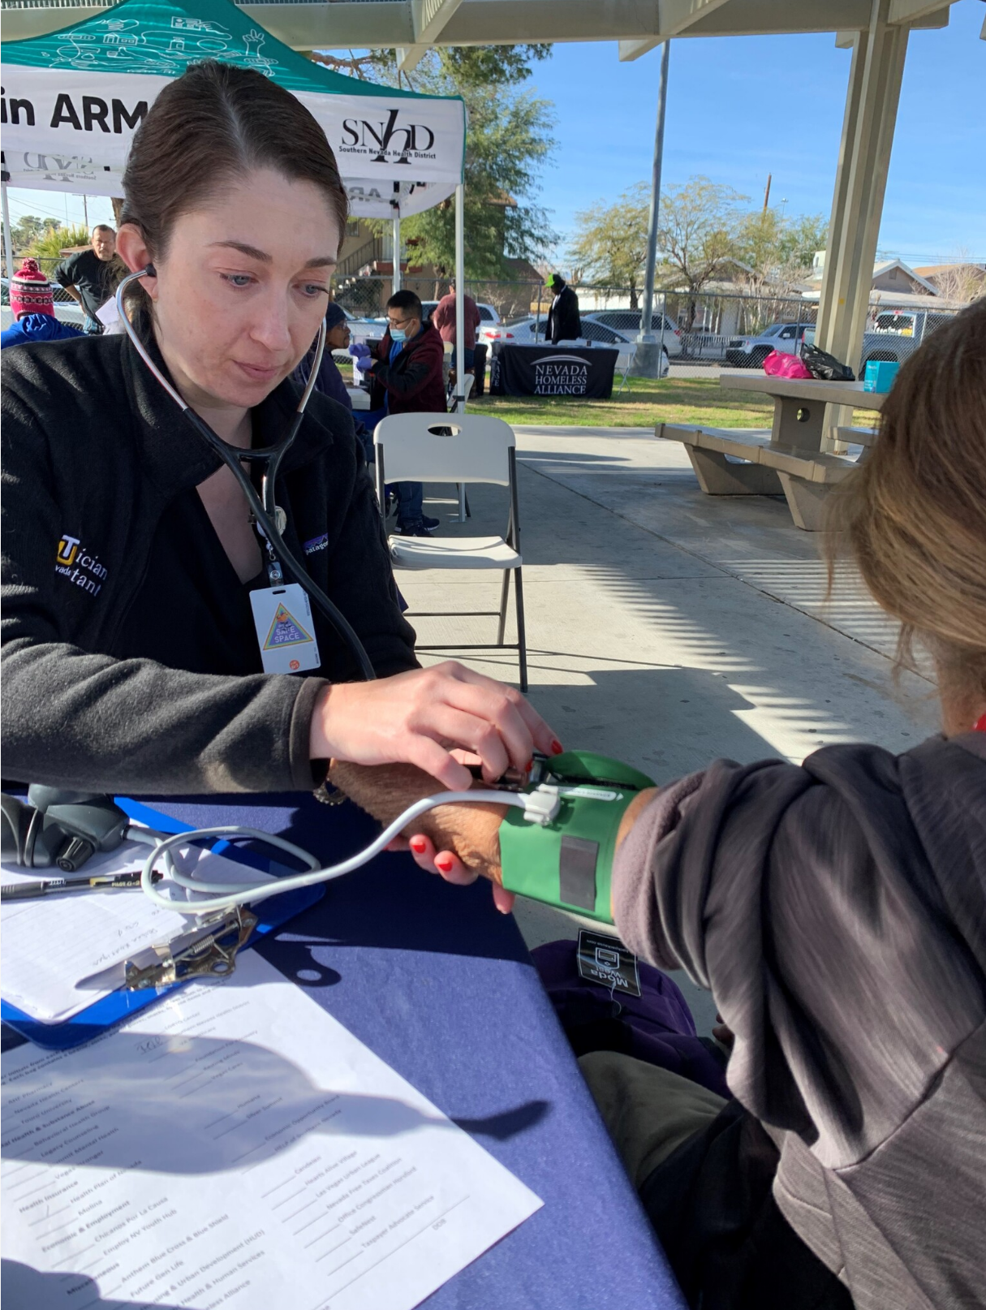
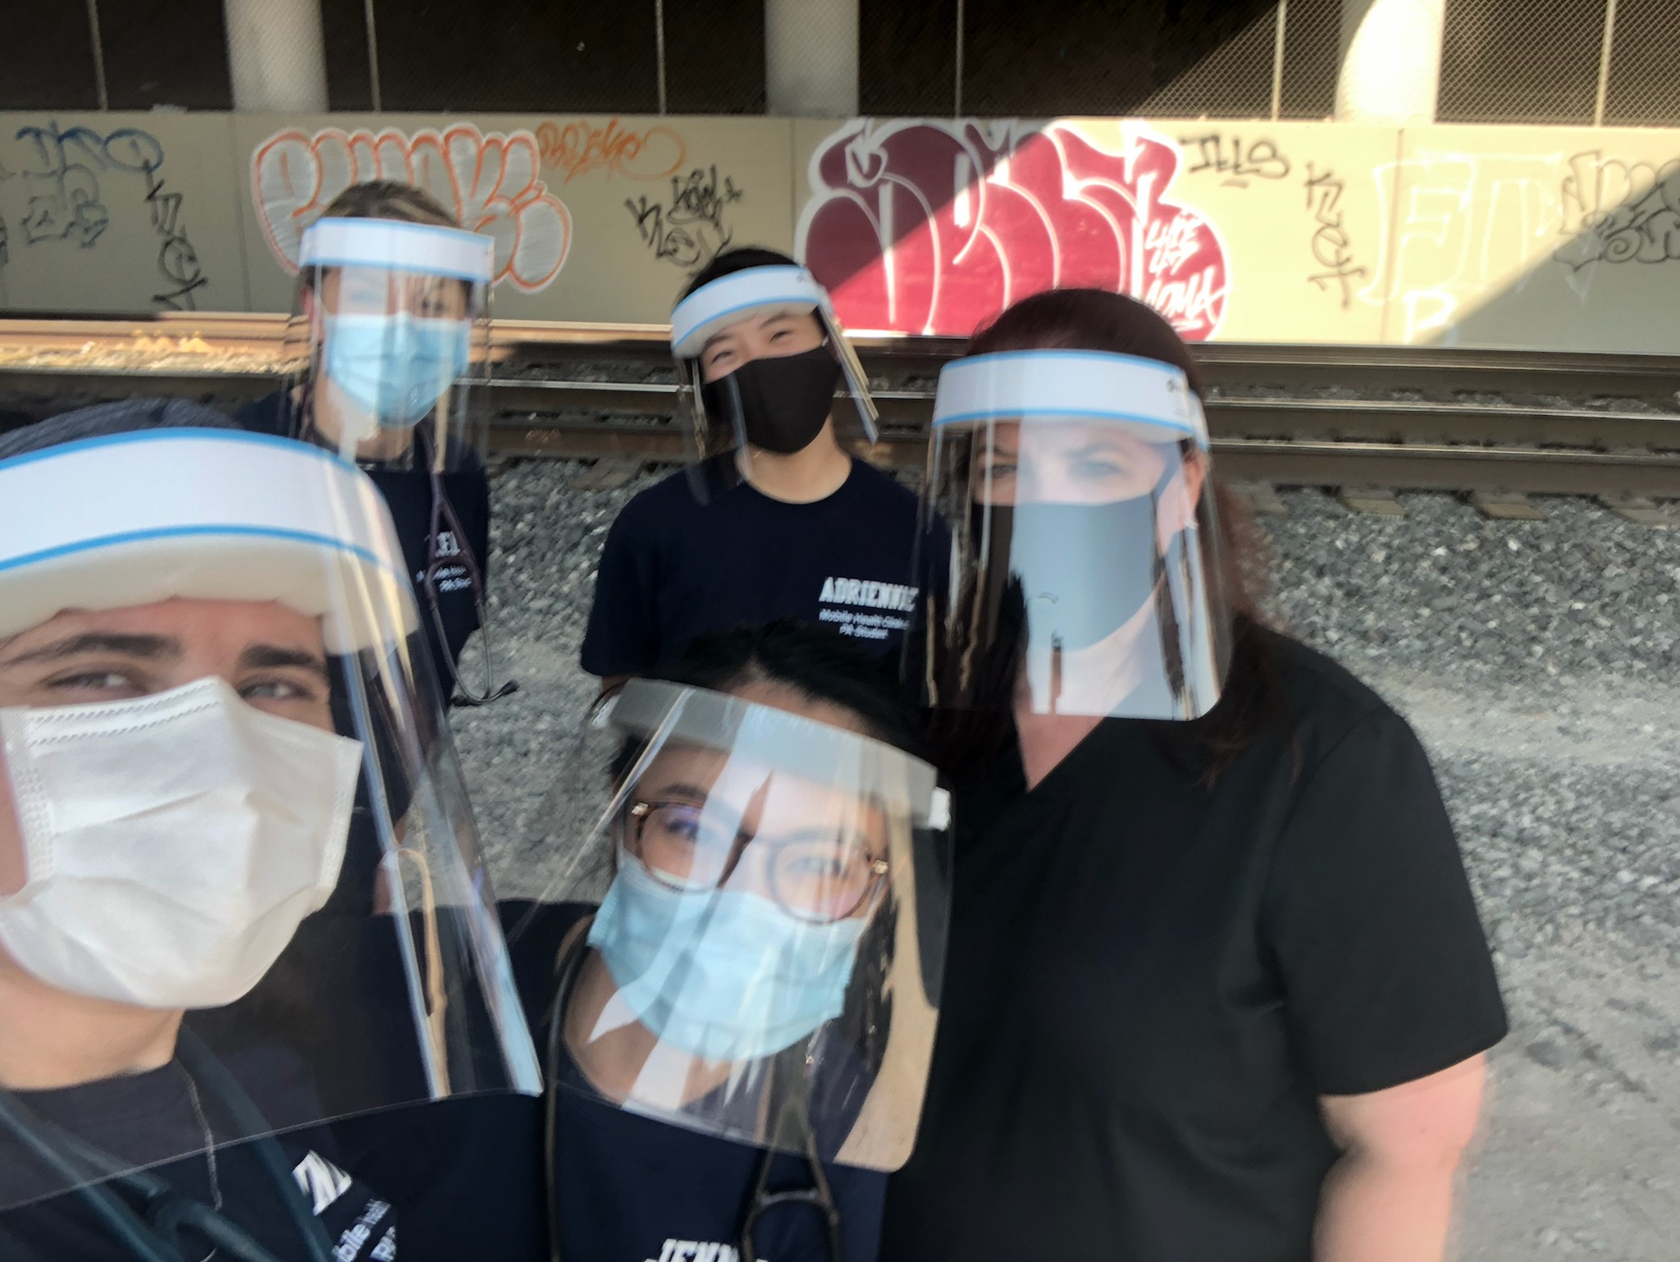
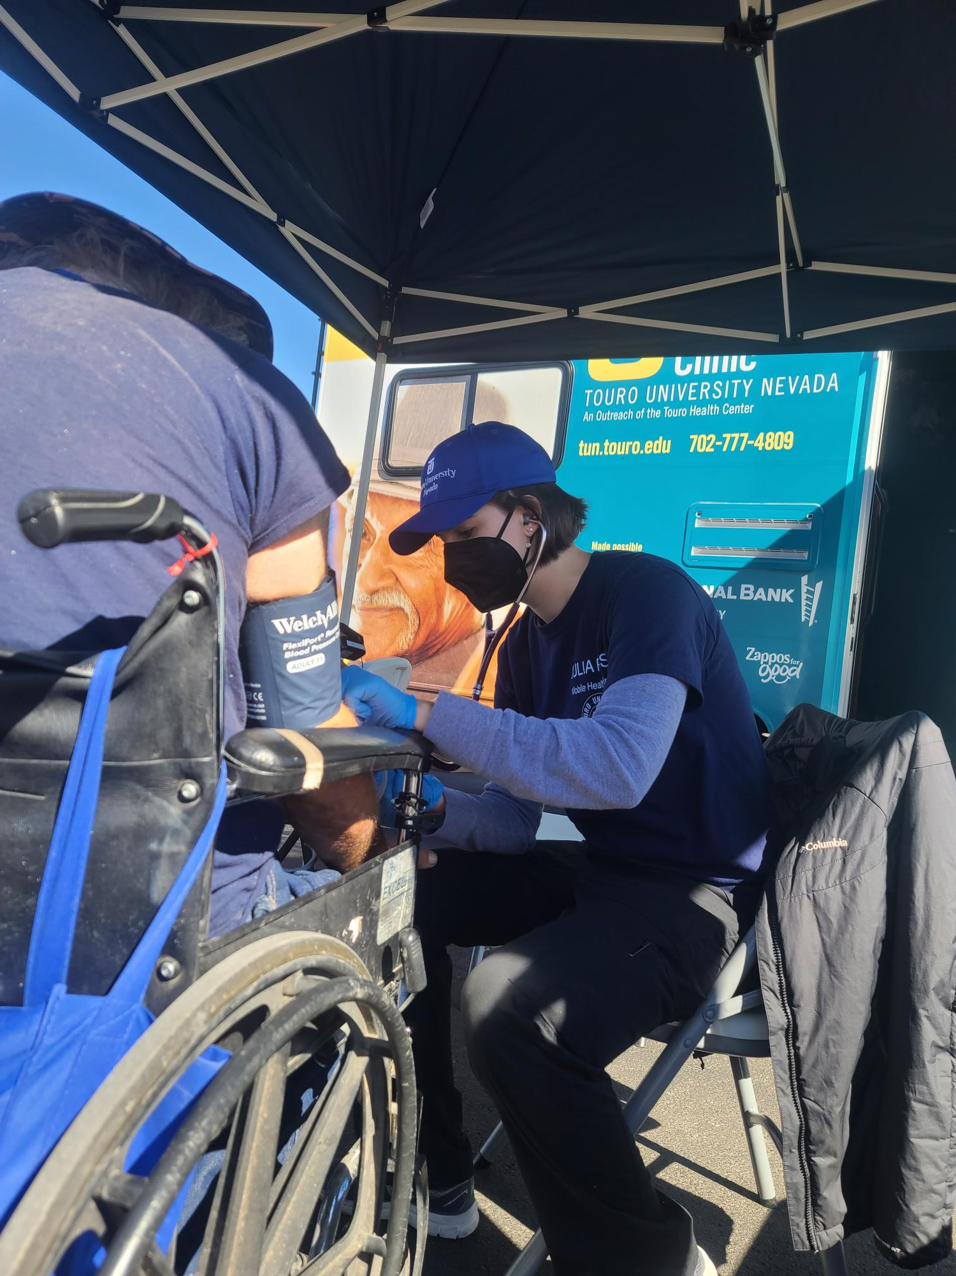
University Based Community Outreach
University-based medical care for underserved populations benefits the students, the university and the community
Brings medicine to where people are

Slide 4
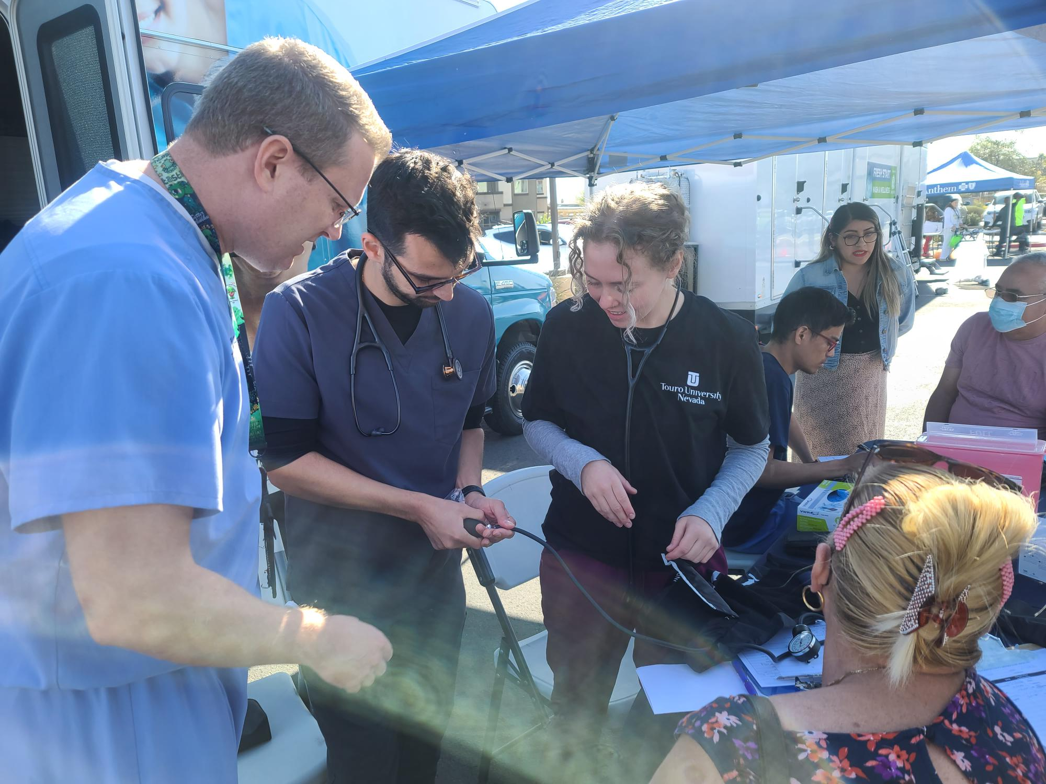
Community Outreach
Benefits to the student:
Clinical practice
Exposure to underserved patient populations
Promotes compassionate practitioners

Slide 5
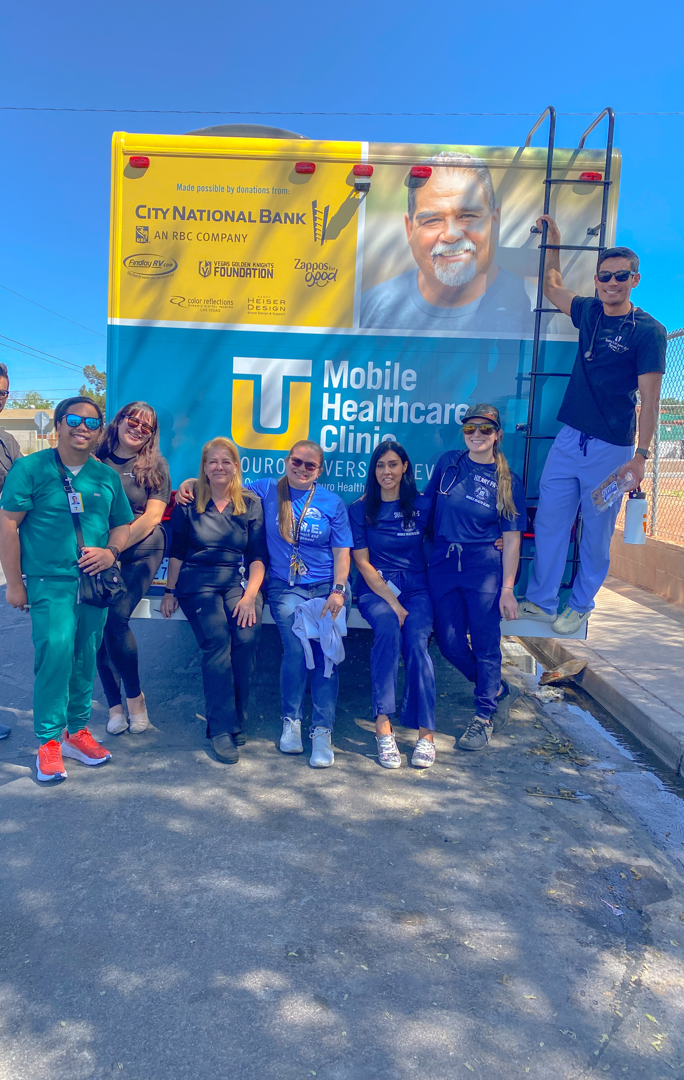
Community Outreach
Benefits to the University:
We are known in the community to provide care
Our community outreach attracts excellent applicants
This experience helps shape truly excellent providers

Slide 6
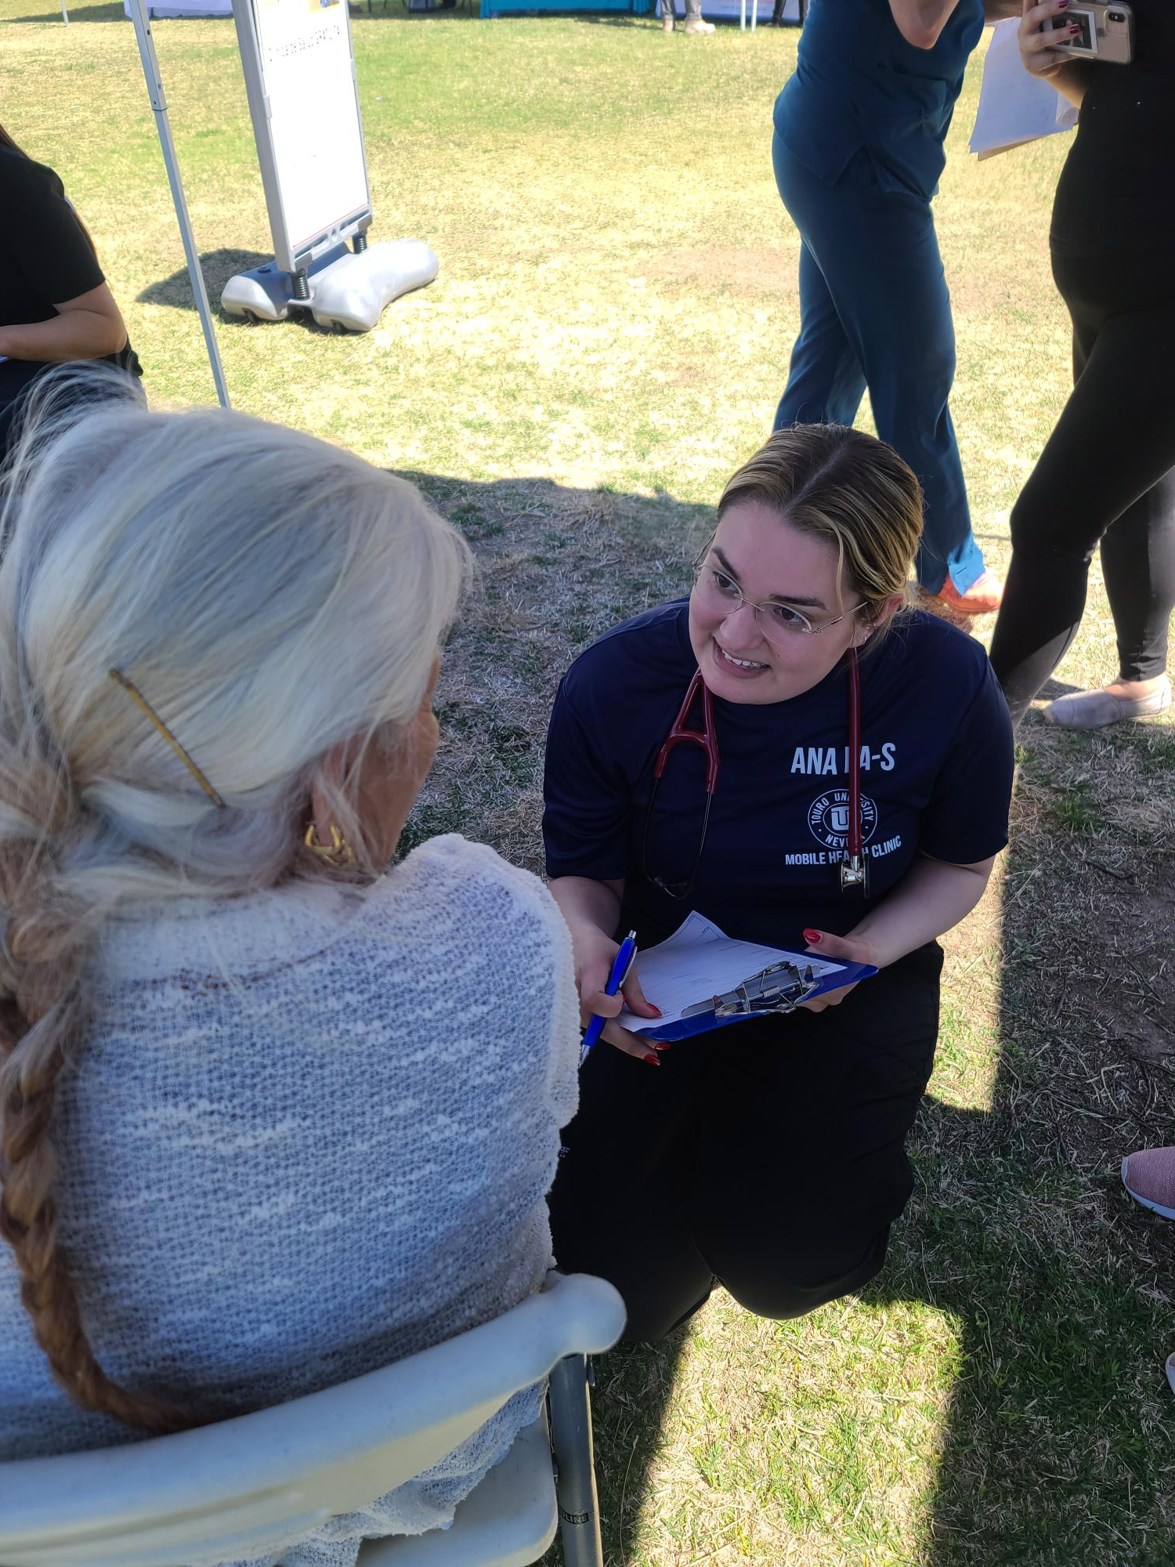
Community Outreach
Benefits to the community:
Providing medical care to those without access
Improving the health status of the community
Connecting capable providers to our community

Slide 7

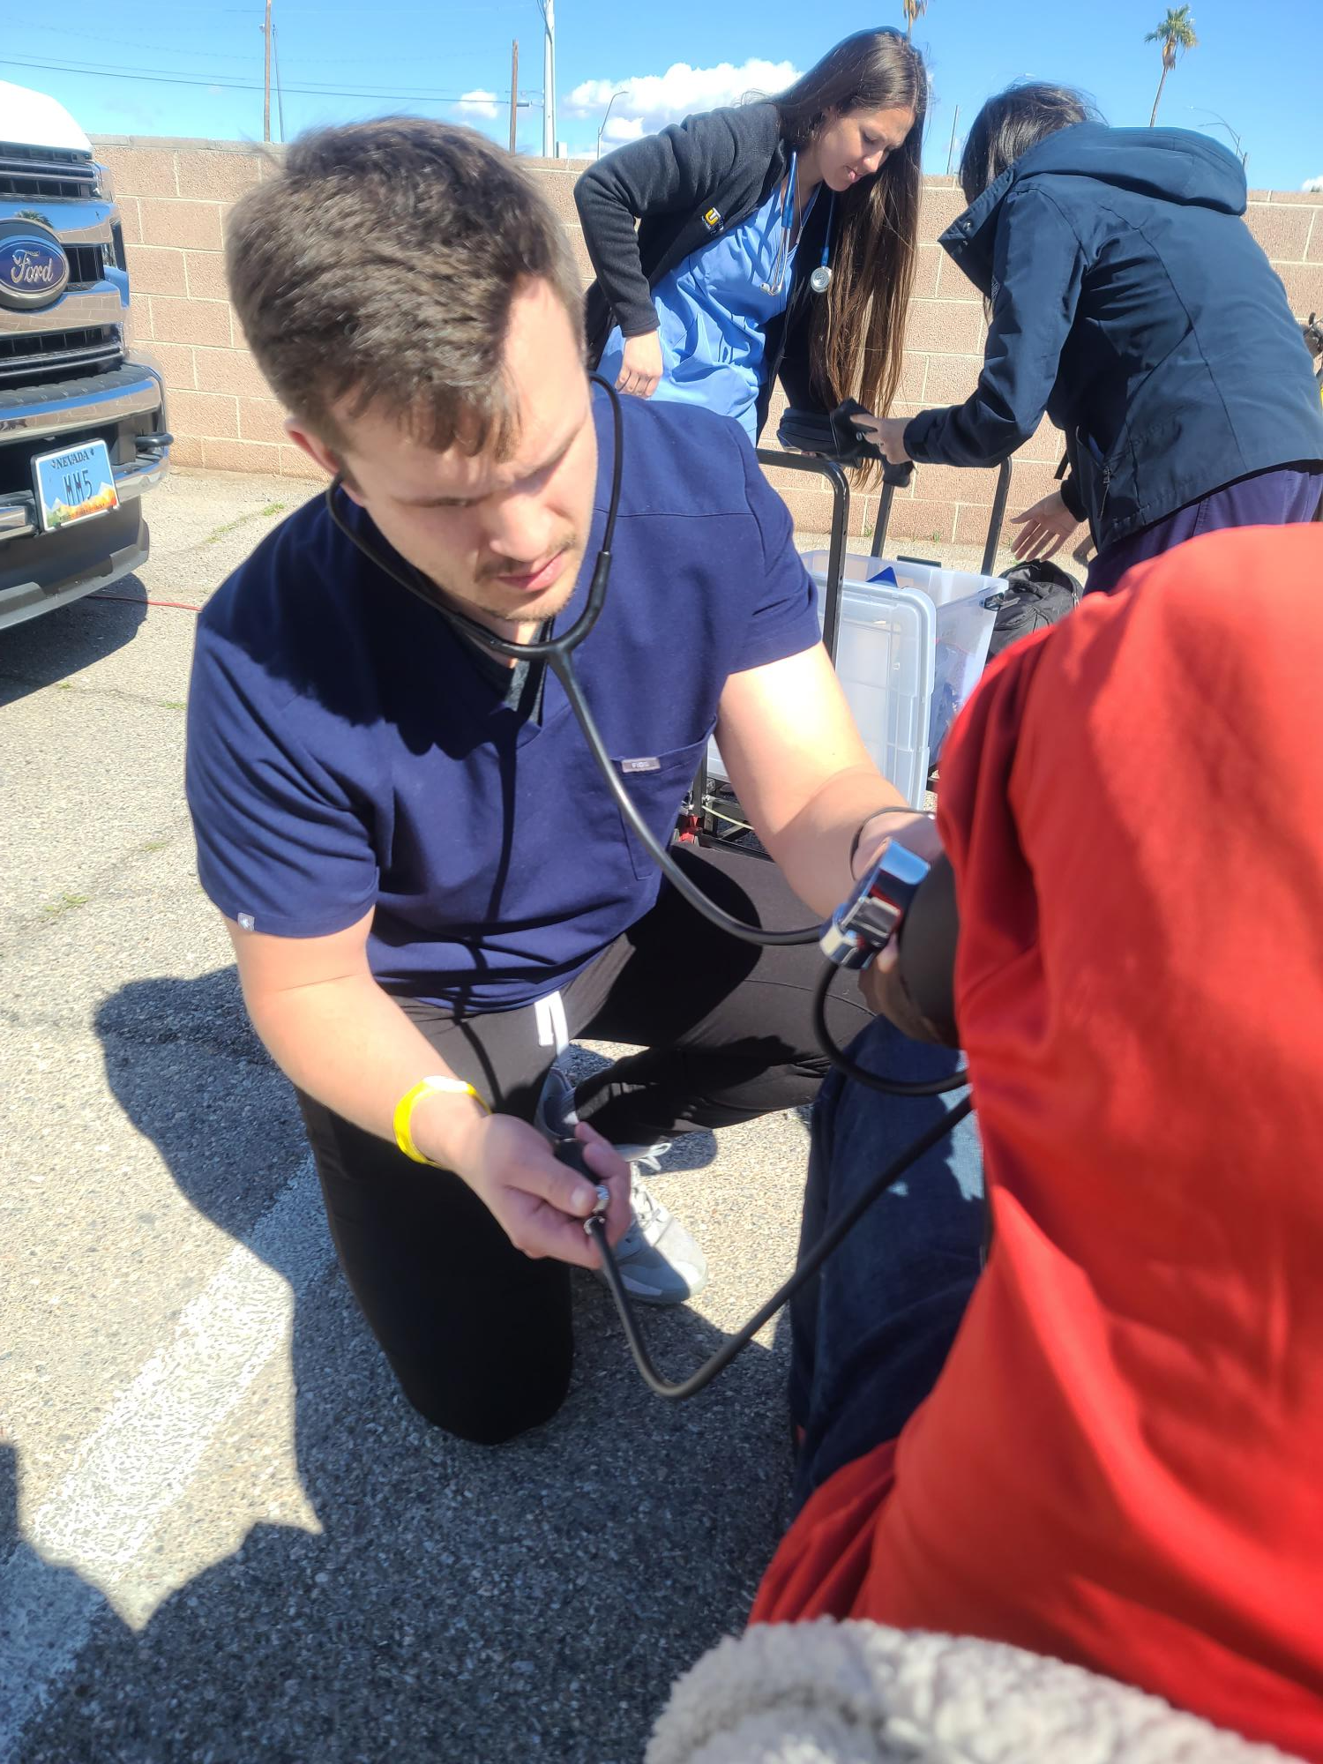
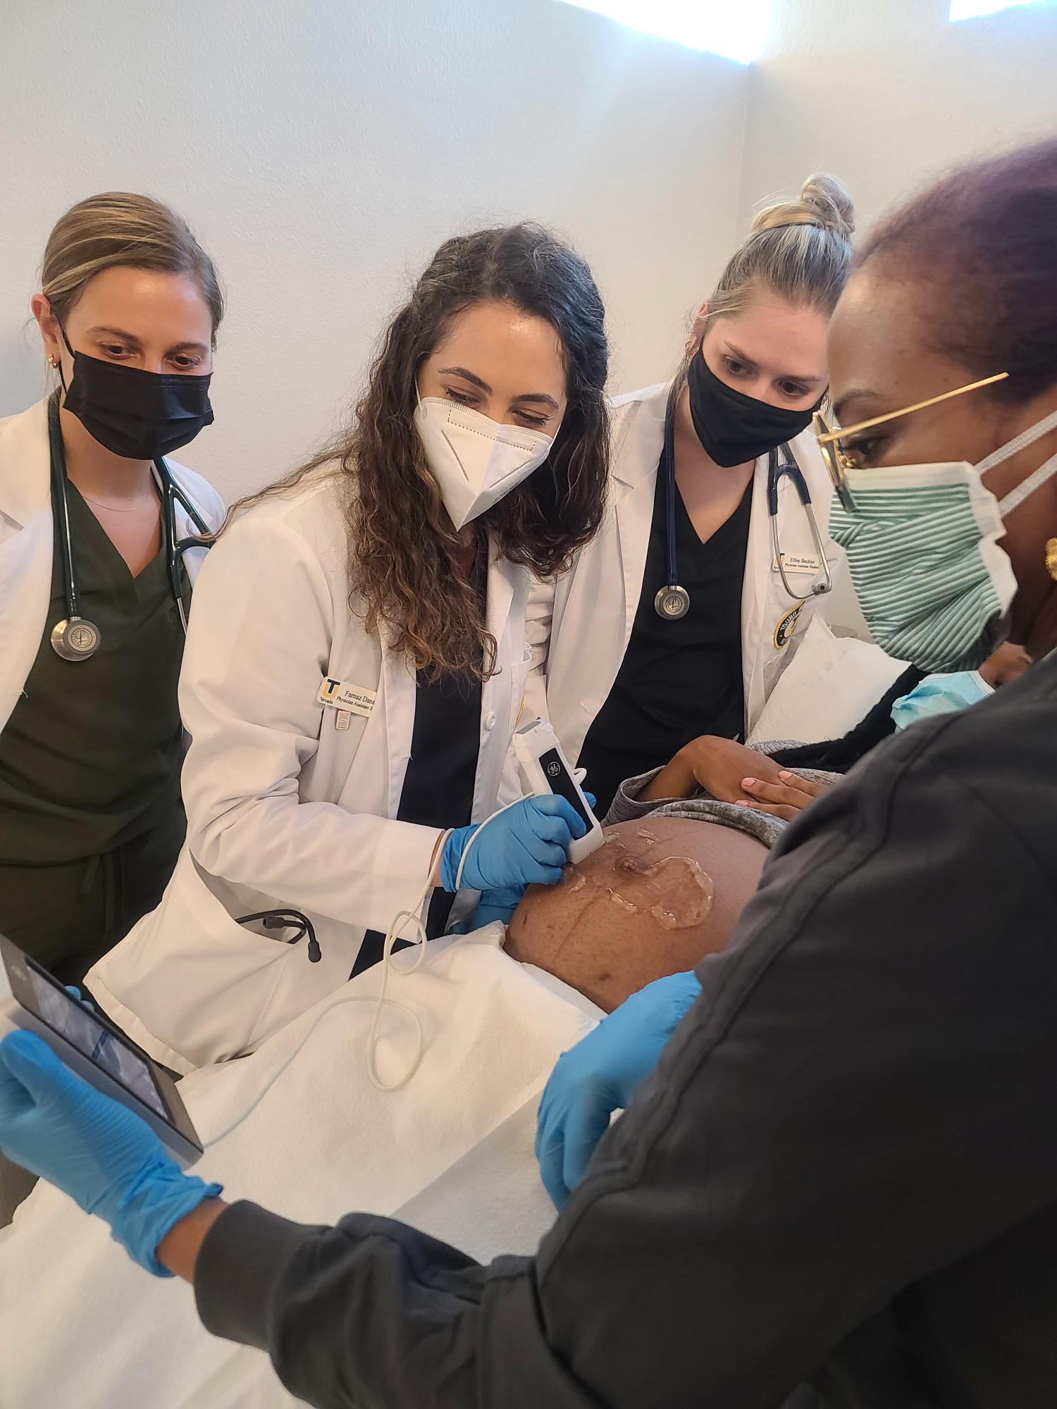
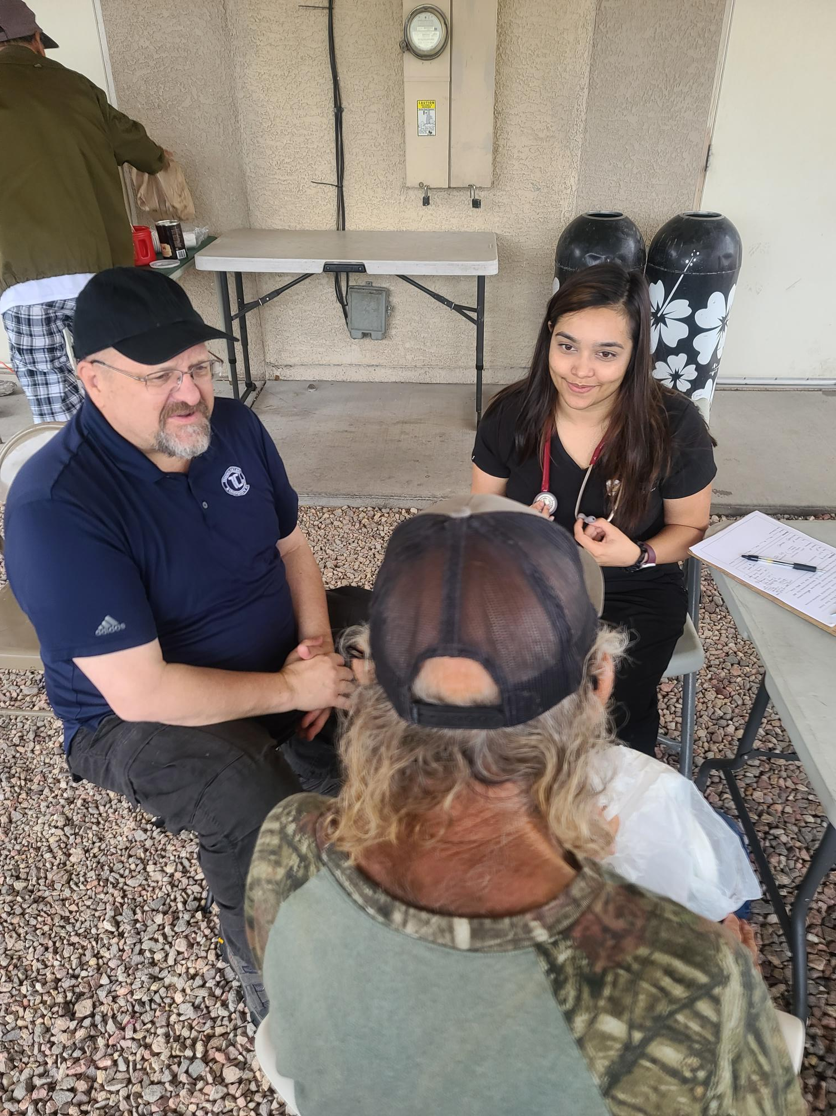
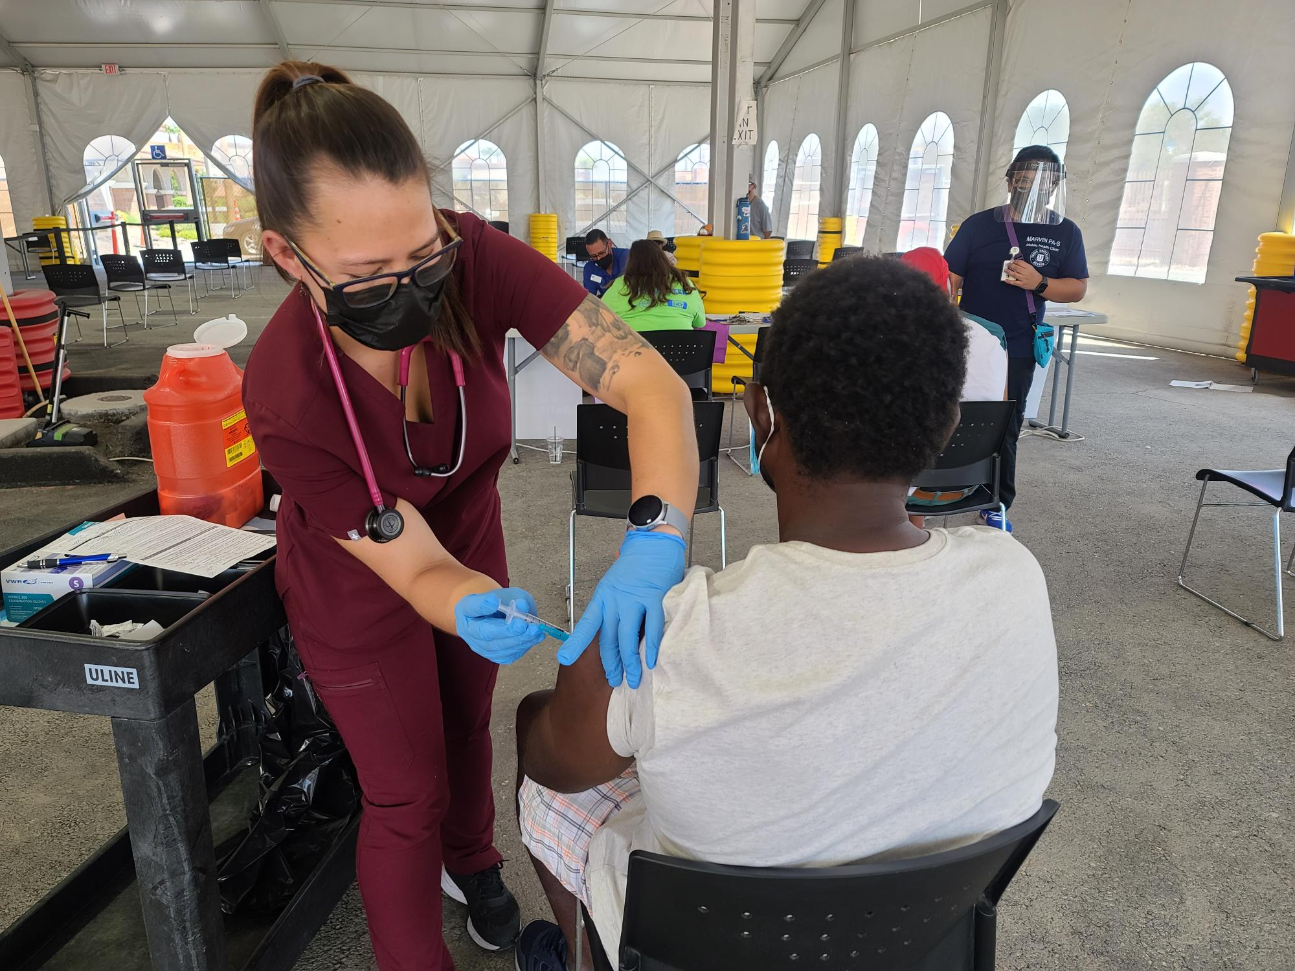
Touro’s Community Outreach
Medical care:
  Shelters
  Unsheltered
  DV shelters
Vaccination PODs – COVID (>11k), influenza, and Mpox
Chair medical/dental section for Project Homeless Connect (PHC)

Slide 8
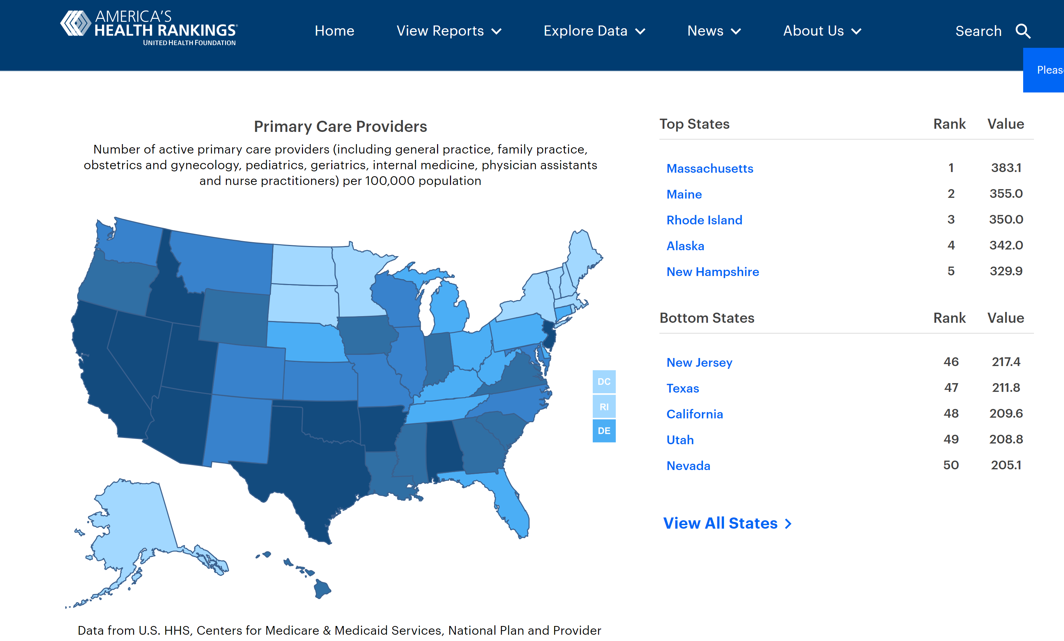

Slide 10
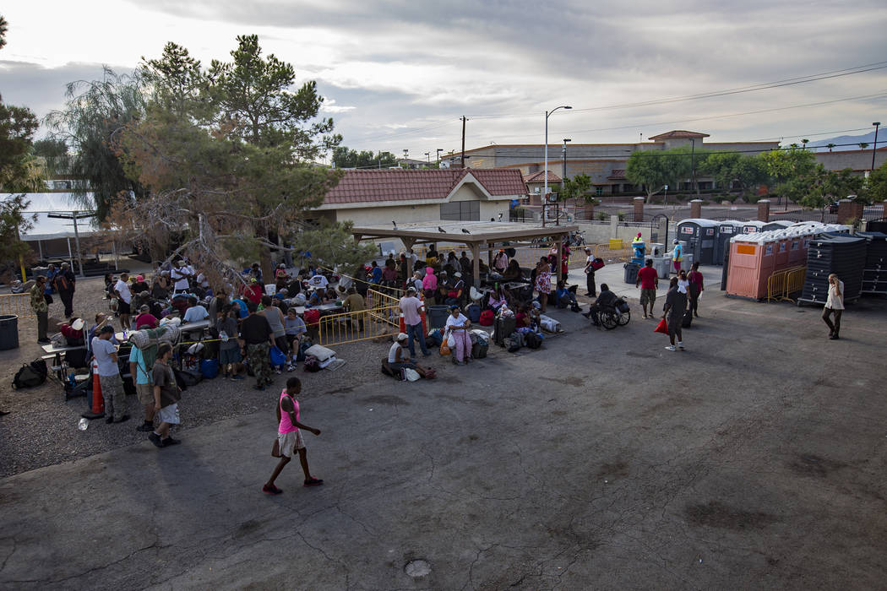
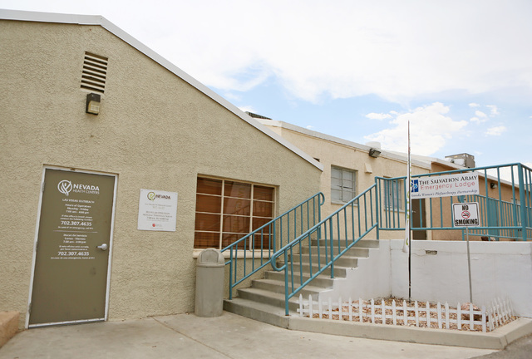
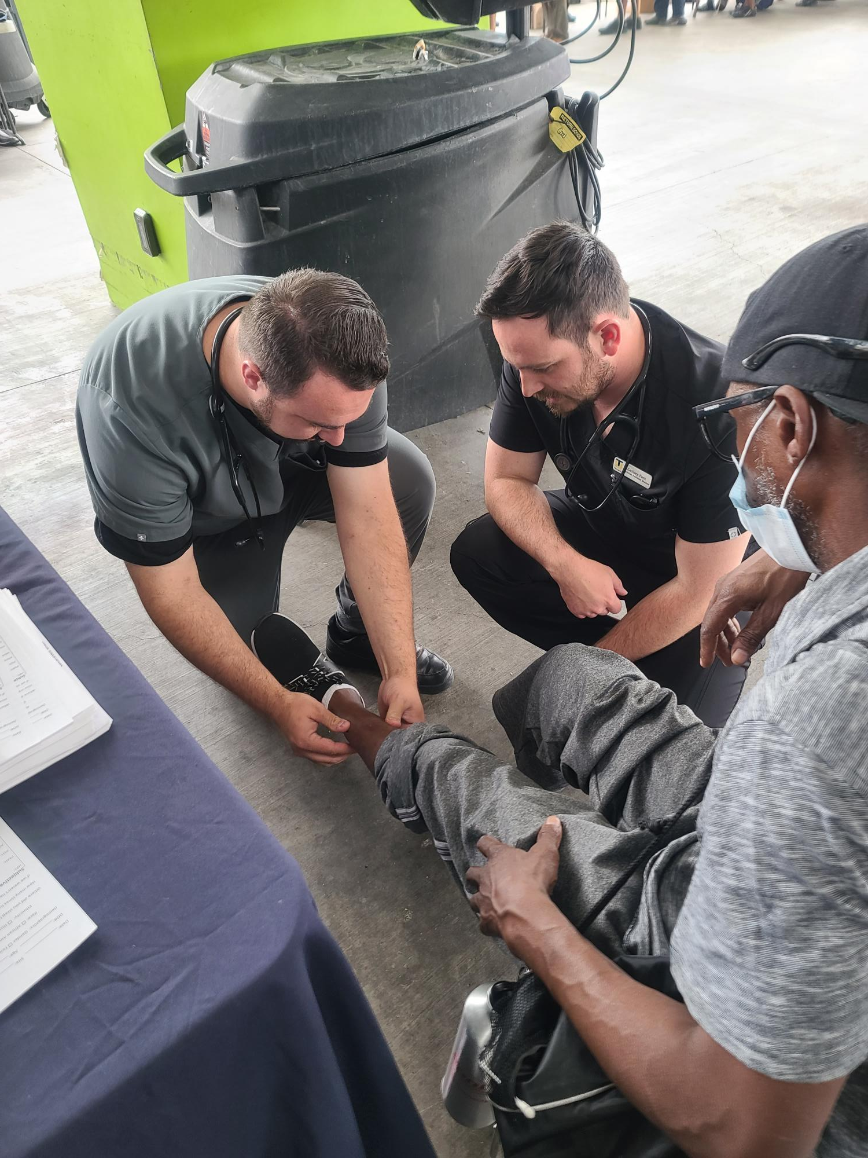
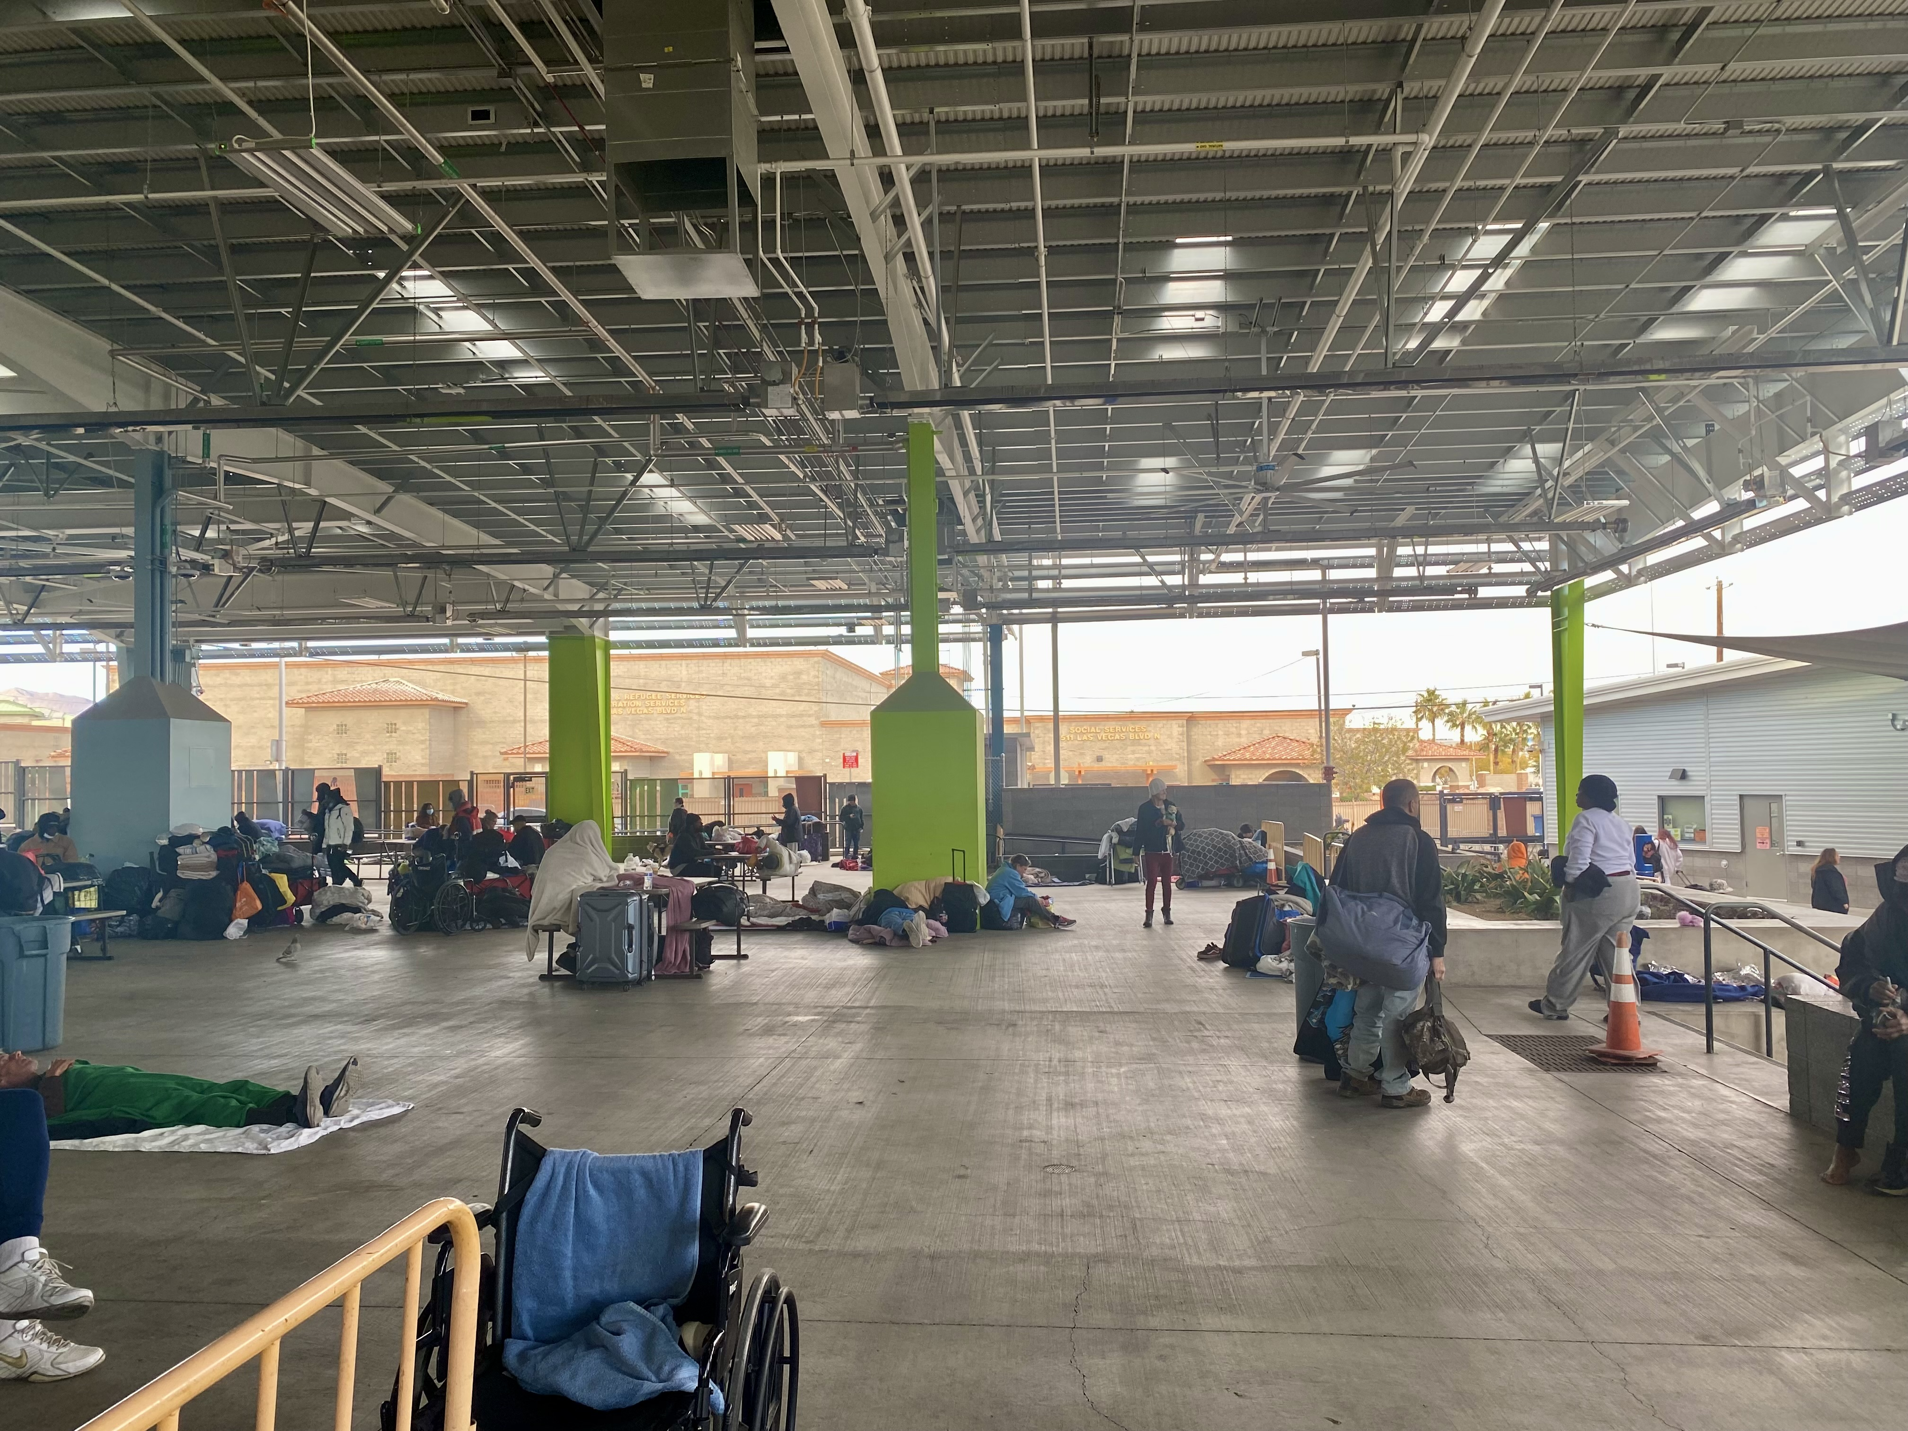
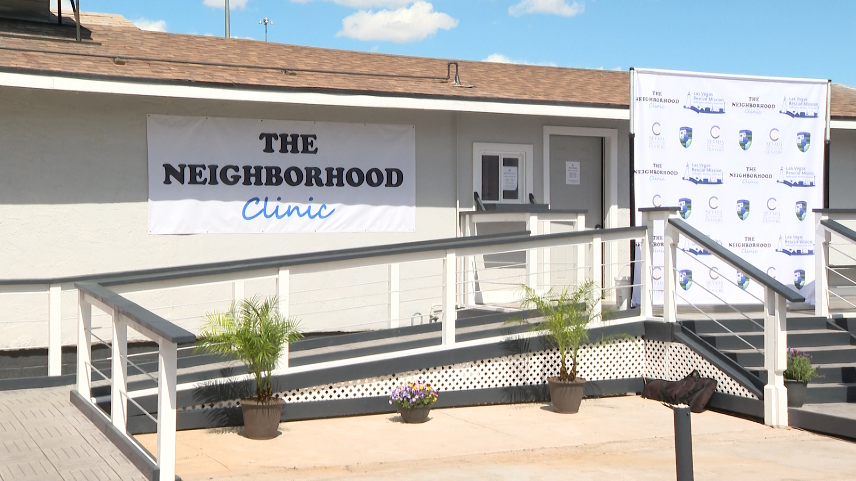
Bring Care to the People

Slide 11
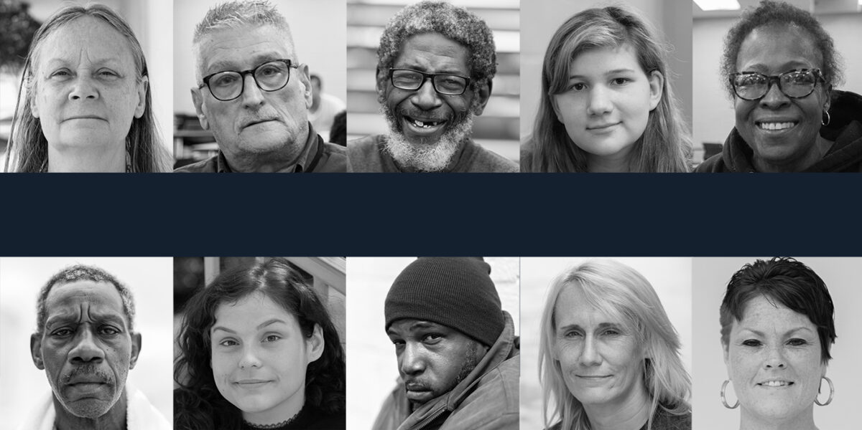
PEH are not a Homogenous Population

Slide 12

Intersectionality
Merriam-Webster: the complex, cumulative way in which the effects of multiple forms of discrimination (such as racism, sexism, and classism) combine, overlap, or intersect especially in the experiences of marginalized individuals or groups
Professor Kimberlé Crenshaw – 1989
Columbia Law School Professor

Slide 13
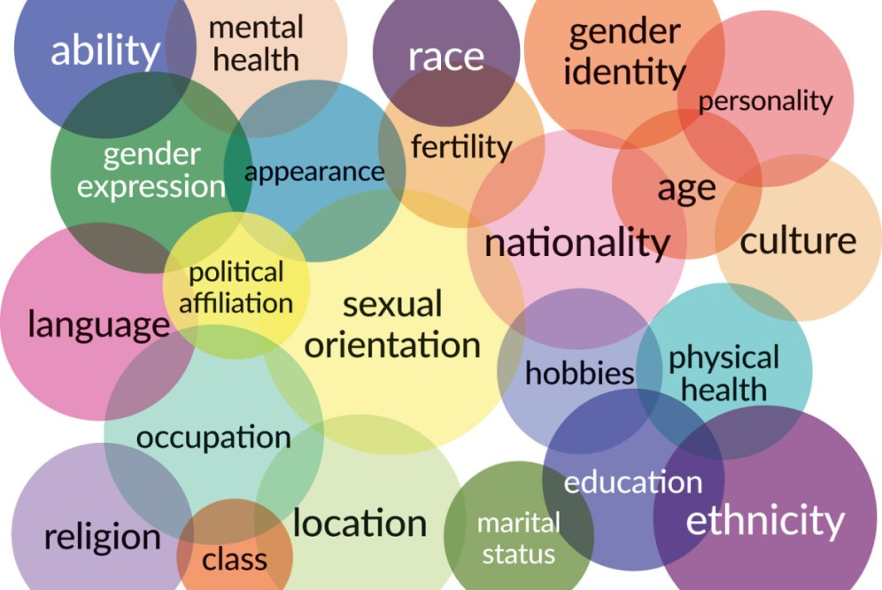
Intersectionality
Intersectionality is the acknowledgement that everyone has their own unique experiences of discrimination and oppression, and we must consider everything and anything that can marginalize people – gender, race, class, sexual orientation, physical ability, etc.

Slide 14
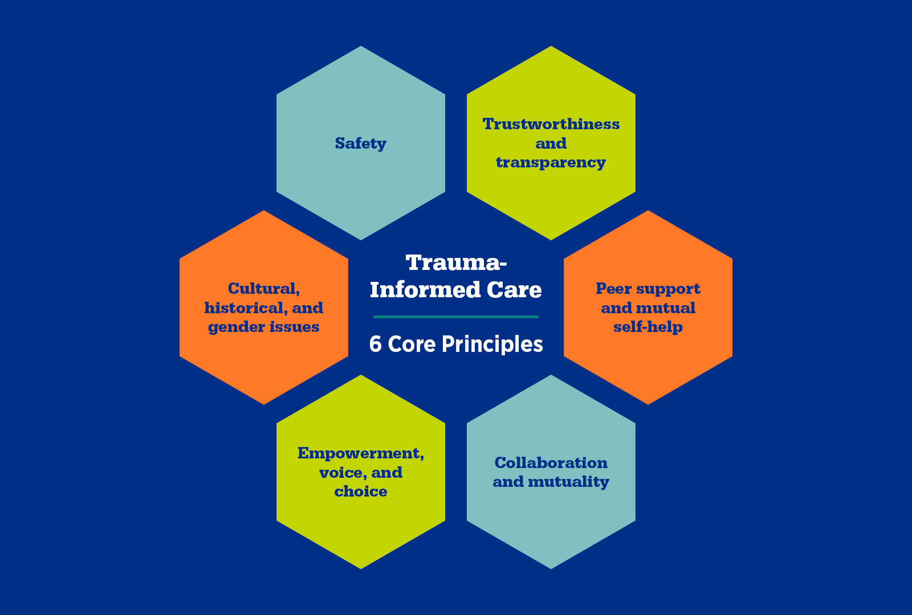
Trauma Informed Care
Focused care vs. treating the whole patient
Avoid re-traumatizing the patient

Slide 15
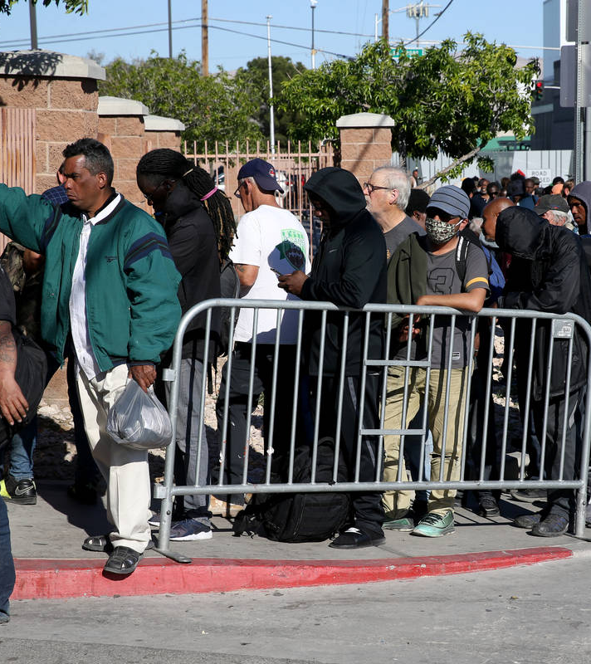
PEH Populations
Chronic homelessness
Women
LGBTQ+
Children and transitional youth
Seniors (NV ≥ 60)
Serious mental illness (SMI)
Substance Use Disorder (SUD) and Alcohol Use Disorder (AUD)
Immigrants

Slide 16

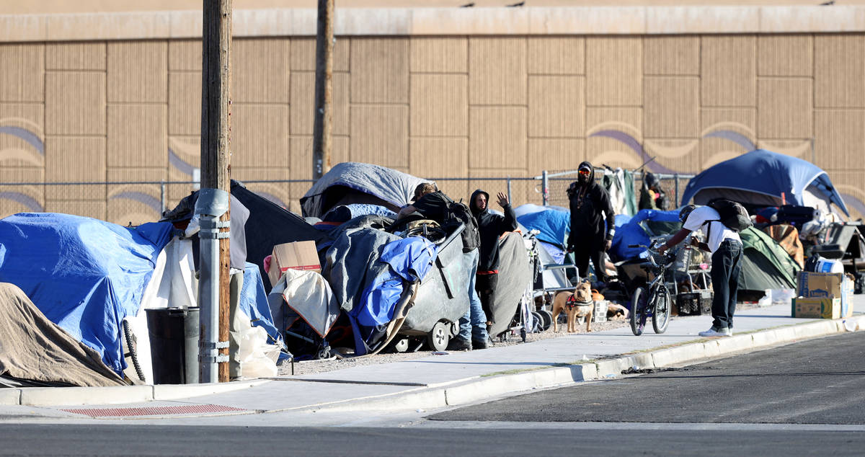
Southern Nevada Statistics
Point in Time (PIT) Census from 2022:
5,645 were experiencing homelessness
Sheltered 49% and unsheltered 51%

Slide 17
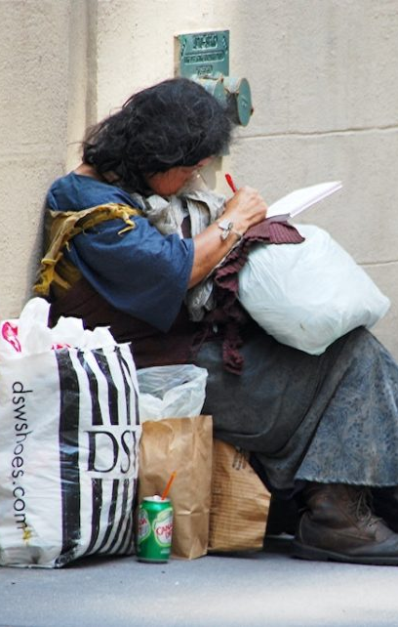
Women - Statistics
S NV PIT census 2022 28.4% of PEH were women
National statistics 13.3% of PEH are women
Female PEH are more likely to experience:
  Sexual assault, trafficking, intimate partner violence
  Higher rates of mental health conditions, poor health status, poor birth outcomes, and mortality
Unaccompanied women experiencing homelessness rising
  May be denied resources available to unhoused families
  May be more likely to be unsheltered
Unlikely to access regular screening medical care

Slide 18
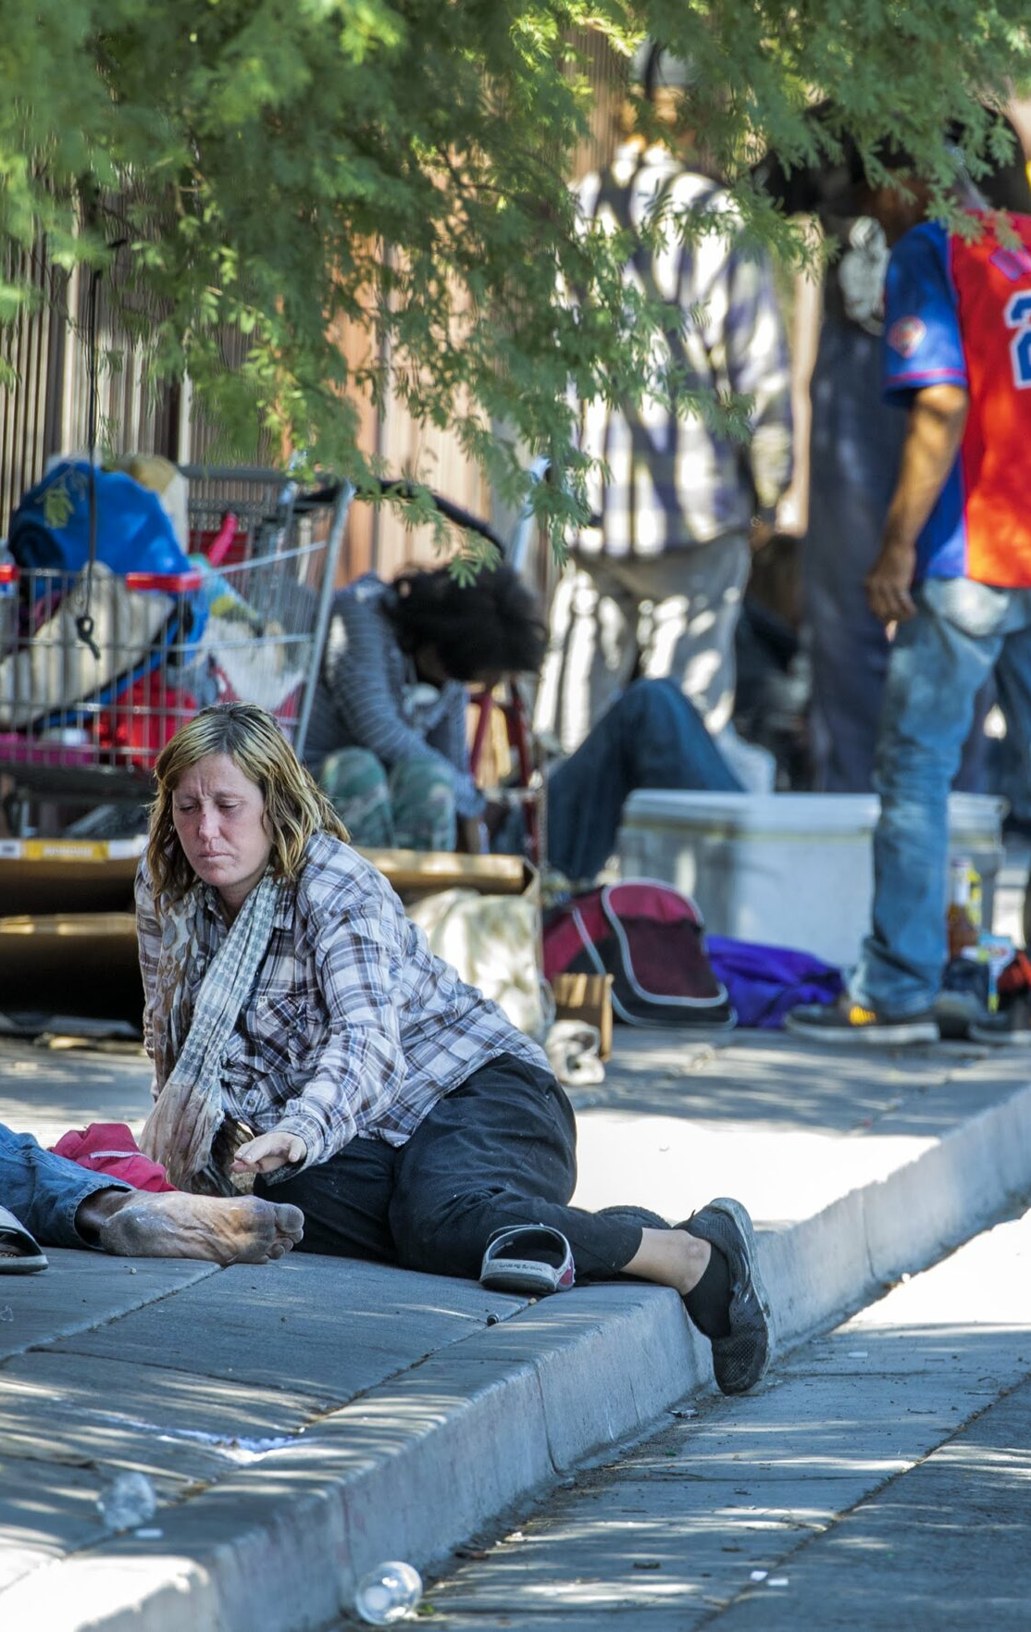
Women – Medical Concerns
Screening/testing:
  Screen for intimate partner violence / general safety
  STIs if sexually active
Treatment:
  Prenatal vitamins if childbearing age
  Providing for menses
Preventative care:
  Birth control (types, risks, availability)
  Gardasil vaccine (11-45yo)
  Pap smears (21-64), mammograms (40-75)

Slide 19
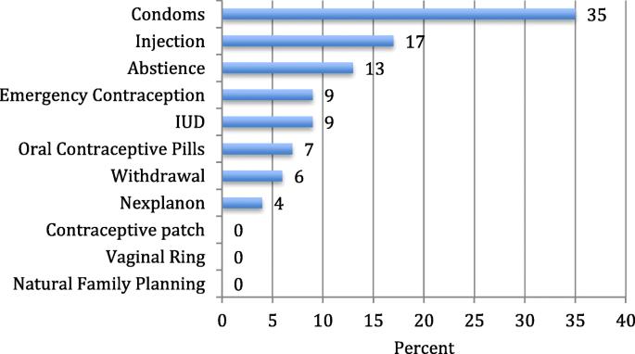
Contraception in PEH
Patient preference
Risks
Benefits
Barriers
Counseling
https://contraceptionmedicine.biomedcentral.com/articles/10.1186/s40834-020-00113-w

Slide 20
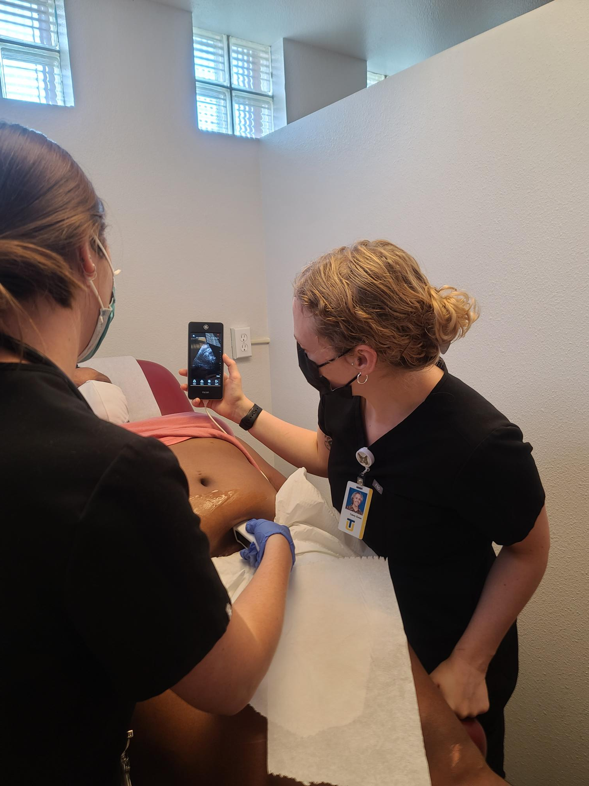
Women - Pregnancy
Desire to continue pregnancy
Early pre-natal care is key
Pregnancy tests
Pre-natal vitamins
Counsel on harm reduction
Encourage good decisions

Slide 21
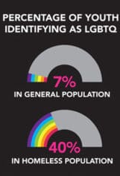
LGBTQ+ - Statistics
Study in UCLA showed 17% of LGBTQ people had experienced homelessness at one point in their lives
40% of homeless youth identify as LGBTQ+
LGBTQ homeless youth 45% prevalence of suicidal thoughts
May be harassed in shelter by peers or staff
Are more likely to engage in “survival sex” (exchange of sexual favors for basic needs food/clothing/shelter)
Are more likely to be victims of sexual violence
May not feel comfortable seeking medical care

Slide 22
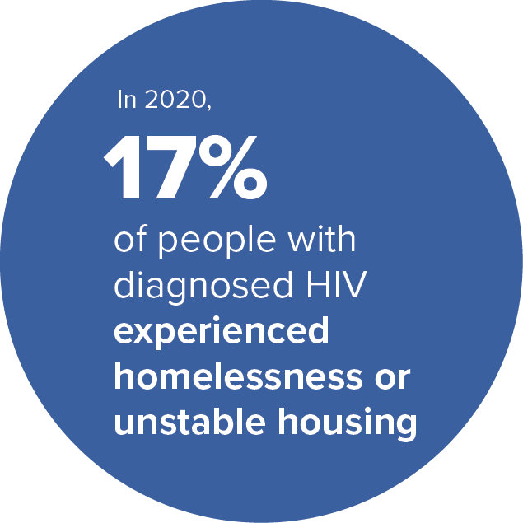
LGBTQ+ HIV Care and Prevention
Reduce harm – counsel, condoms, needles
PeP (post-exposure prophylaxis)
  Given within 3 days of exposure to prevent HIV infection
PreP (pre-exposure prophylaxis)
  For the prevention of getting HIV infection
  Sexual exposures - Apretude injection is given once every other month and 99% effective
  IVDU exposures – Daily pills are 74% effective
HIV – New or old diagnosis
  Connection to care is key (Ryan White)
  Decrease barriers to care – warm hand-off

Slide 23
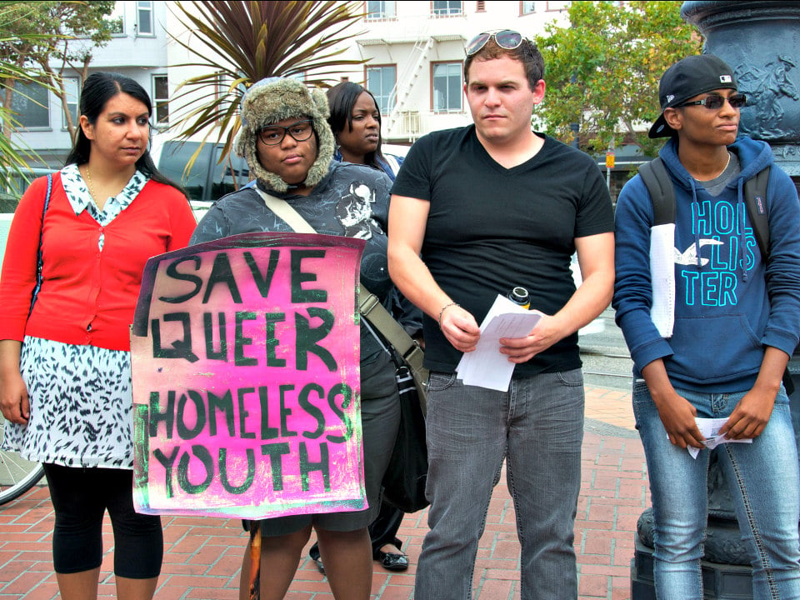

LGBTQ+ - Medical Concerns
Screening/testing:
  Intimate partner violence / general safety
  STIs if sexually active
  Depression screening
Treatment:
  Address harm reduction
  In a non-judgmental facility that caters to LGBTQ+
Preventative care:
  PeP and PreP
  Mpox vaccines

Slide 24
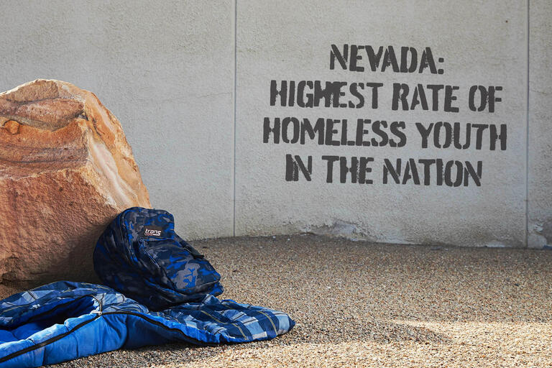
Youth and Transitional Youth –
Statistics
S NV PIT census 2022
  6% of PEH were children < 18 yo
  6% of PEH were transitional youth 19-23 yo
Less likely to attend school
More likely to be behind in school
URI (4x), ear infections (2x), asthma (4x)
Homeless youth are more likely to suffer from hunger, poor physical and mental health

Slide 25
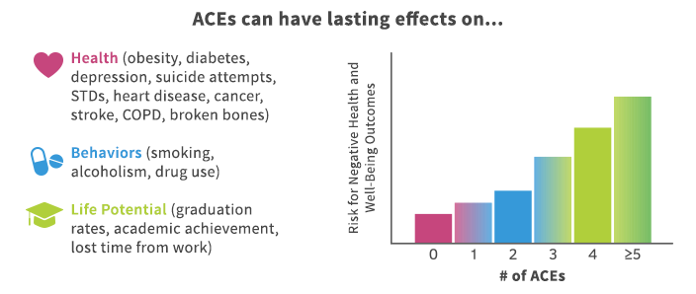
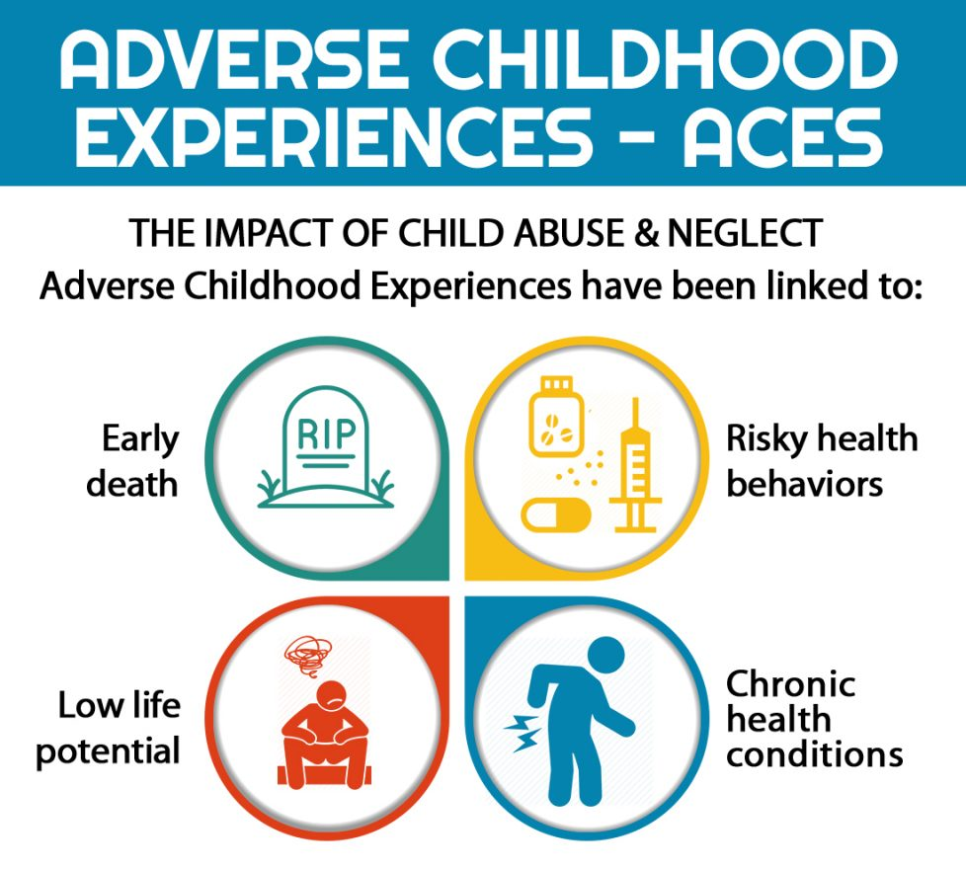
Youth and Transitional Youth - ACEs
Adverse Childhood Experiences (ACEs)
Free test for adults on events < 18yo
  Abuse – physical, emotional , sexual
  Neglect – physical and emotional
  Household dysfunction – Parental MH, SUD, violence, incarceration
Result in significant adult consequences without intervention (diabetes, obesity, SUD, depression, COPD, heart disease)
  6+ average 20 years earlier death

Slide 26

Youth and Transitional Youth –
Medical Concerns
Screening/testing:
  Recognize ACEs
  STIs if sexually active
  Screening for intimate partner violence
Treatment:
  Trauma informed care
  Can be difficult if not an emancipated minor
  General exceptions
Preventative care:
  Childhood vaccines
  Meningitis vaccine
  Gardasil vaccine
  Birth control

Slide 27
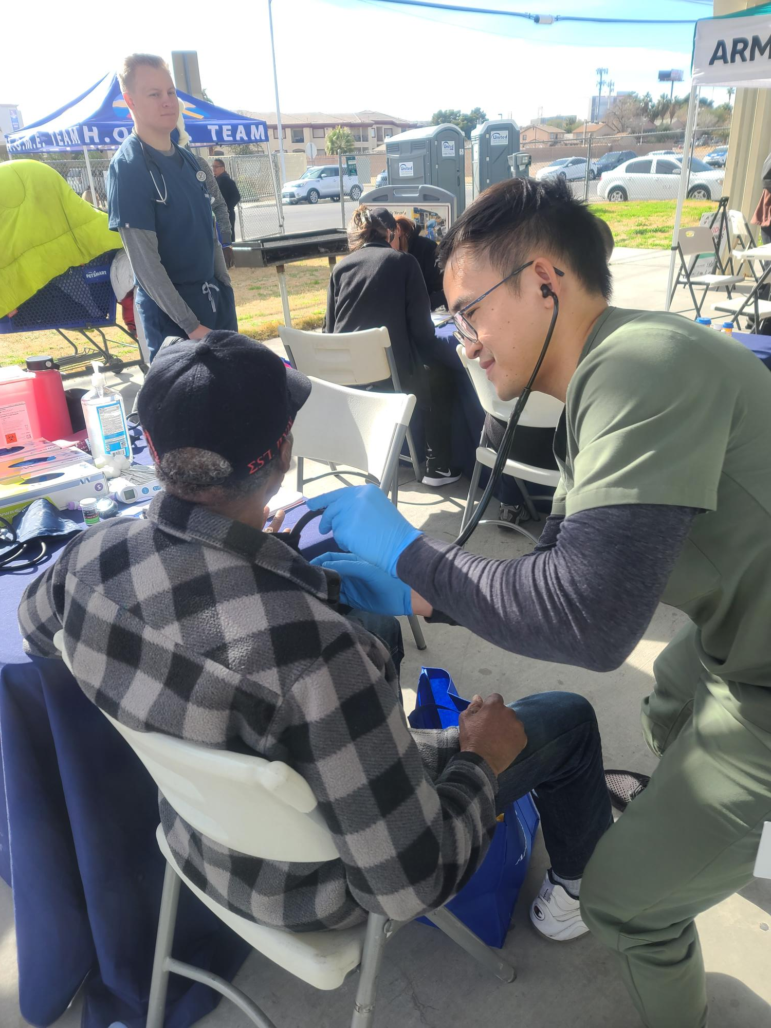
Seniors - Statistics
More likely to have chronic disease
Less resilient in recovery
Less able to tolerate heat
May be unable to afford co-pays for appointments or meds
Free Medicare only covers hospitalizations (may be eligible for Medicaid with Medicare but the system is complex)
Frequently need medical transitional housing

Slide 28
Seniors – Diabetes
Kidney disease
Regular screening is needed
Most common cause of kidney failure
Foot ulcers / amputations
Inspect feet daily
Wear socks and good shoes
Moisturize feet daily
Get sores treated immediately to avoid amputations
Loss of vision
Screening needed, sunglasses
50% more likely cataracts
Retina changes
Cardiovascular disease
Heart attacks / strokes
Heart disease #1 killer

Slide 29
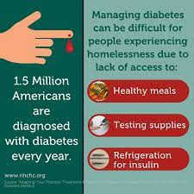


Diabetes
Polyuria, polydipsia, polyphagia
Tend to keep BG elevated
Current algorithm for treatment

Slide 30
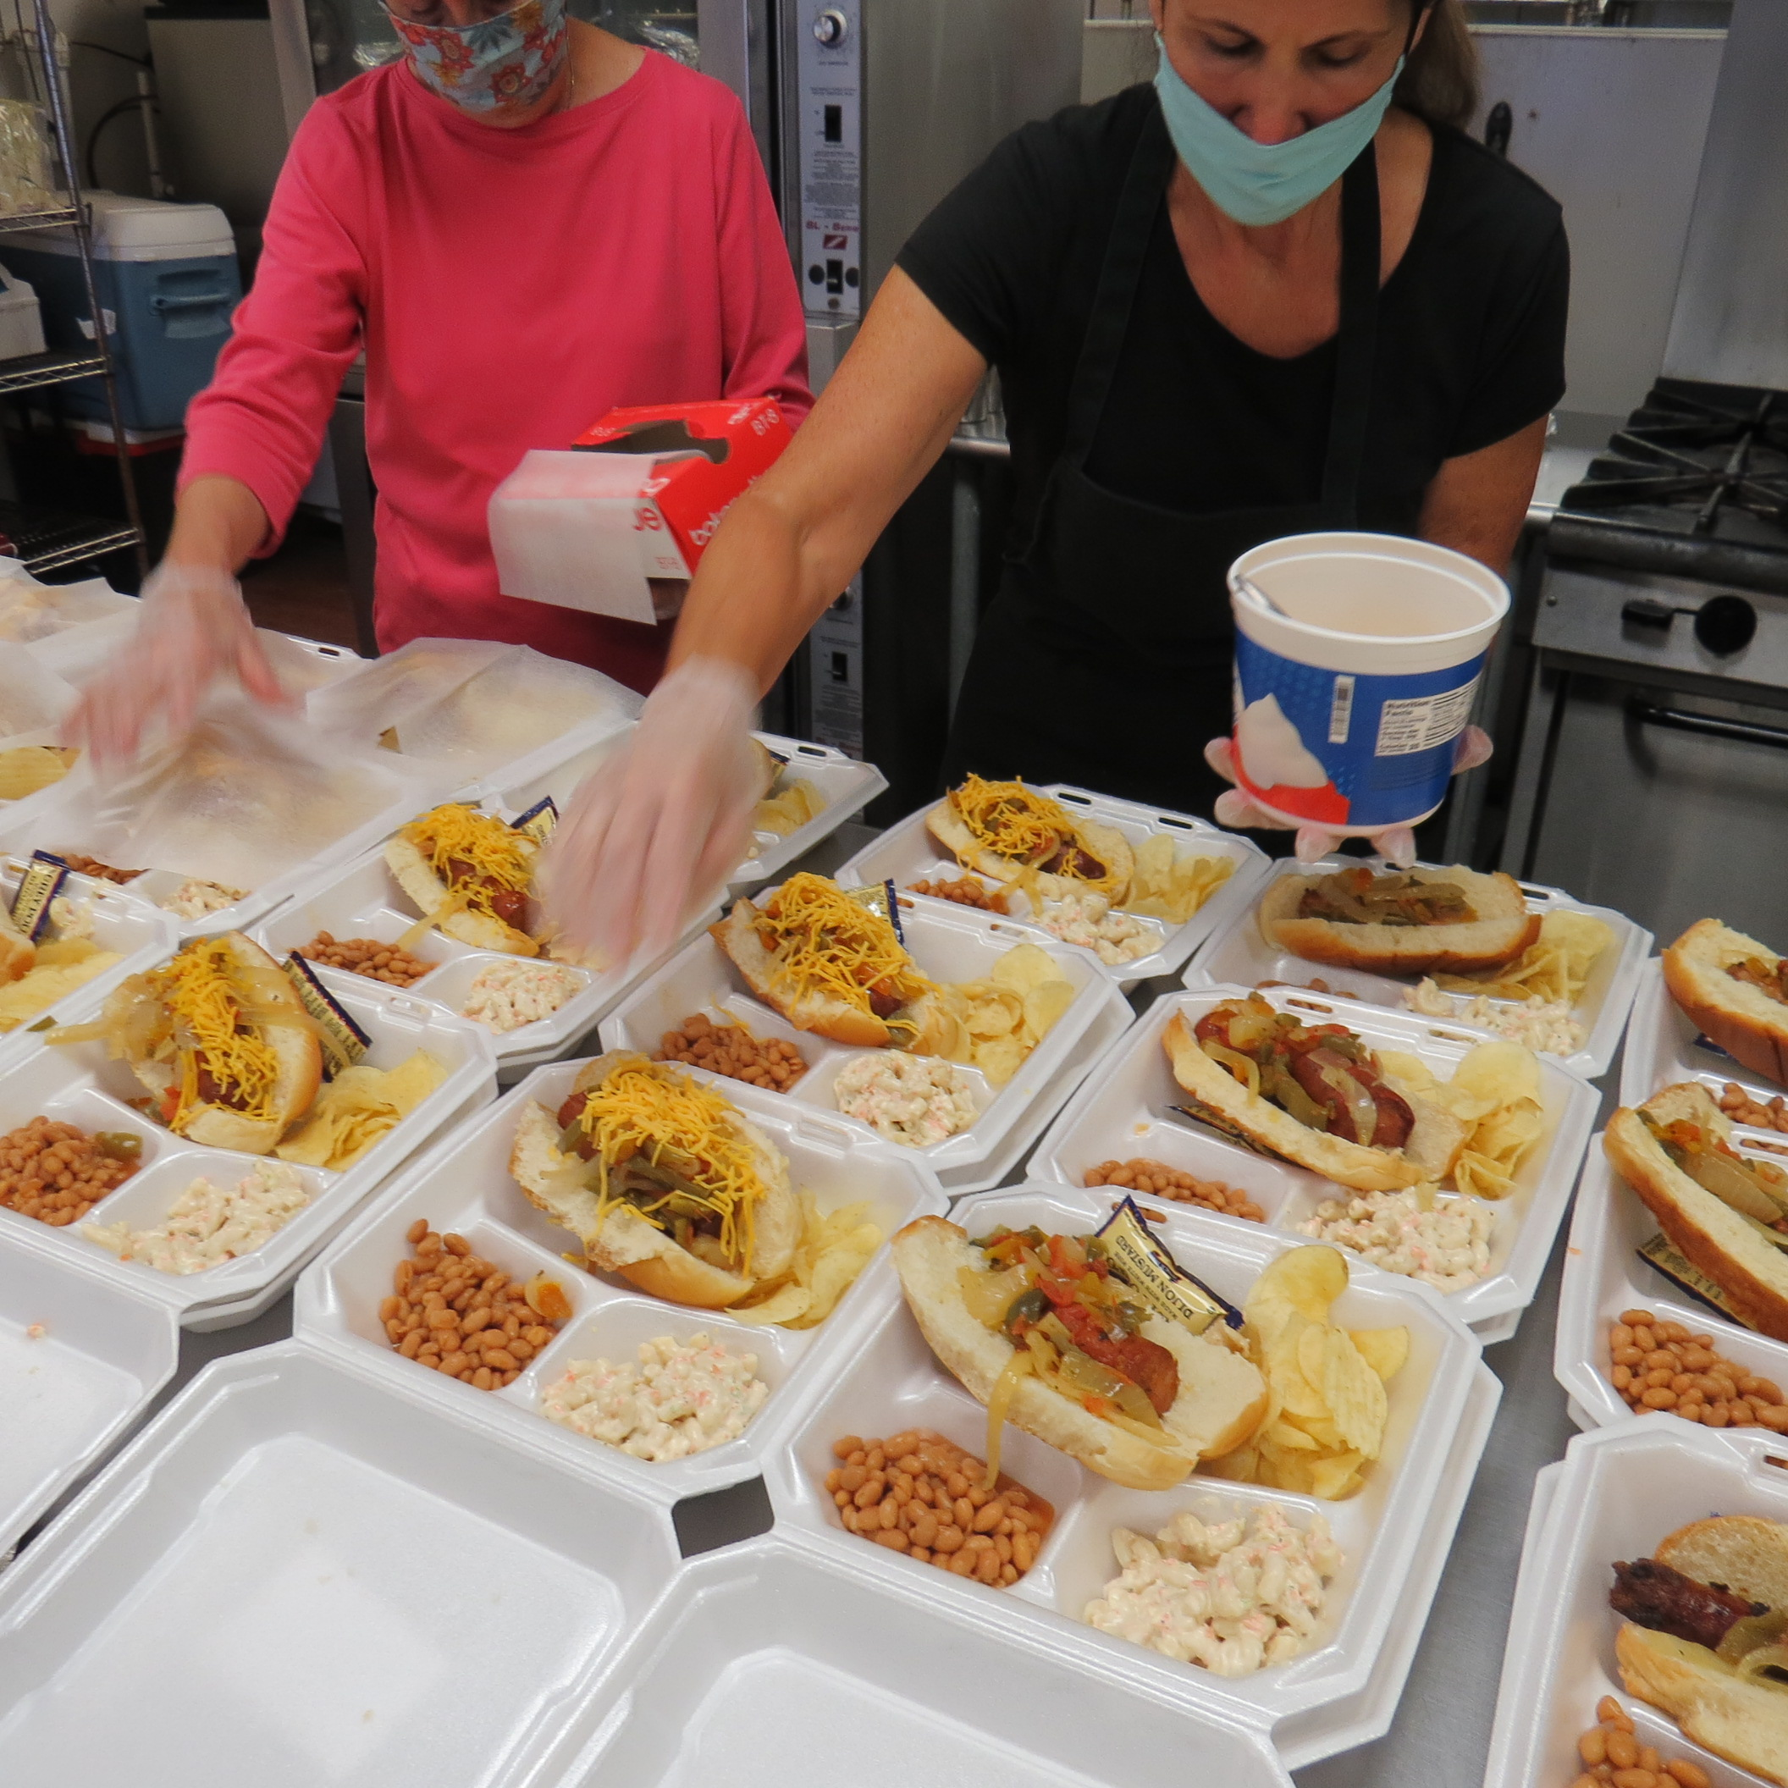
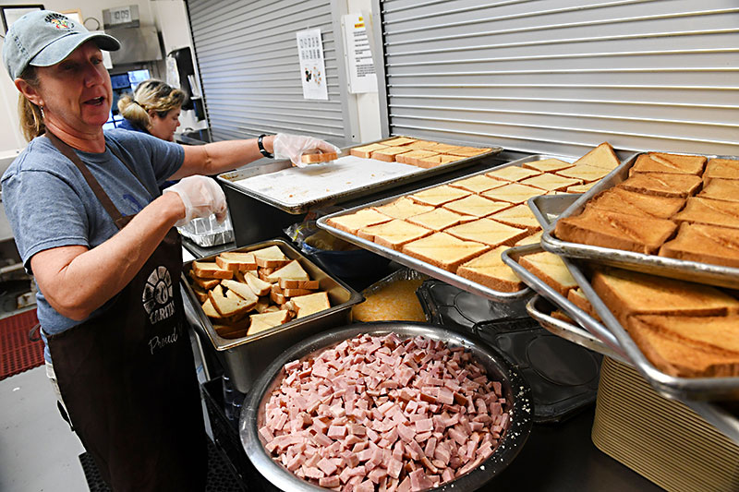
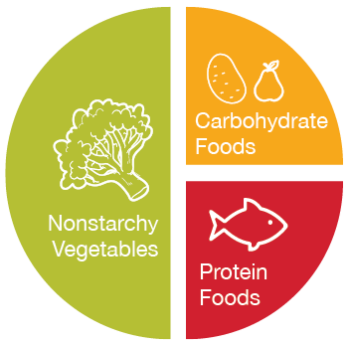



Diabetes – Food Insecurity

Slide 31
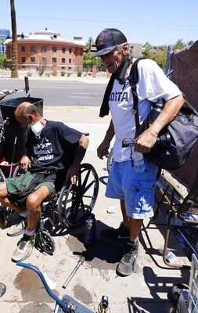
Seniors – Medical Concerns
Screening/testing:
  Chronic health conditions – COPD, diabetes, hypertension, heart disease
  Foot exams
Treatment:
  COPD – inhalers, nebulizers
  Medications for chronic conditions – pills, insulin
Preventative care:
  Eye exams – wear sunglasses!
  Harm reduction – tobacco cessation, obesity
  Vaccines for seniors – pneumonia, high dose flu, COVID, shingles
  Age-appropriate cancer screenings – lung (CT), mammograms, colon

Slide 32
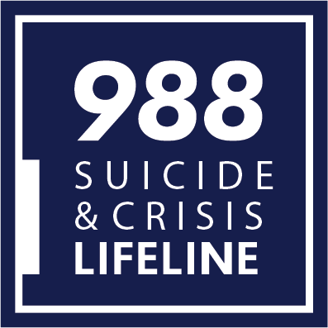
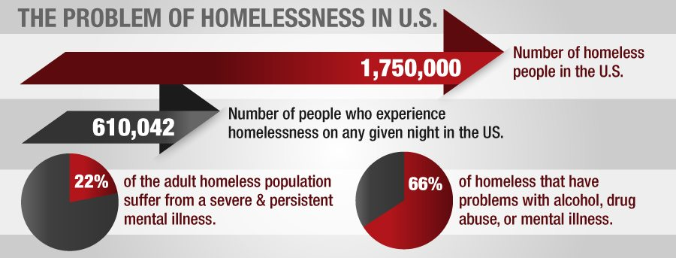
Serious Mental Illness (SMI)
SMI – schizophrenia, manic depressive, severe anxiety
May be quite ill without meeting the threshold for L2K
Frequently people with SMI self-medicate with alcohol/drugs (dual-diagnosis)

Slide 33
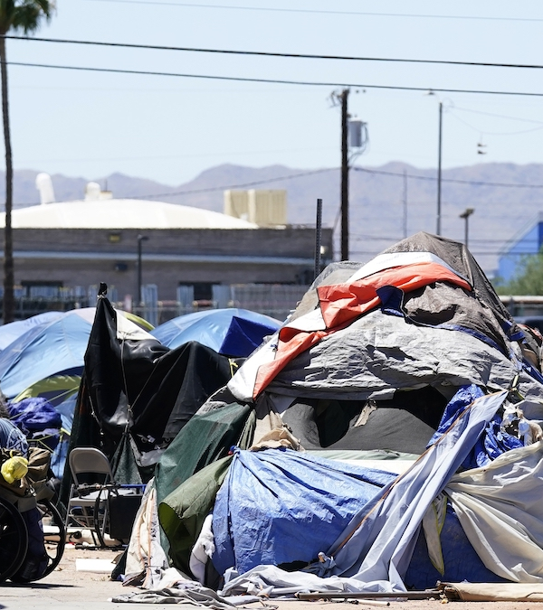
Serious Mental Illness (SMI) –
Medical Concerns
Screening/testing:
  Depression / suicidal ideation
  Evaluation by a psychiatric practitioner
Treatment:
  Need a mental health home / integrated care
  Medication management – injections, fewer barriers
  Autonomy allows for bad decisions
  Medical conditions
Preventative care:
  Treatment before a crisis

Slide 34

Substance Use Disorder (SUD) - Statistics
Over 1/3 of PEH have current alcohol or drug use
National Institute on Drug Abuse – 40% of those with SUD also have a mental health condition (dual diagnosis)

Slide 35
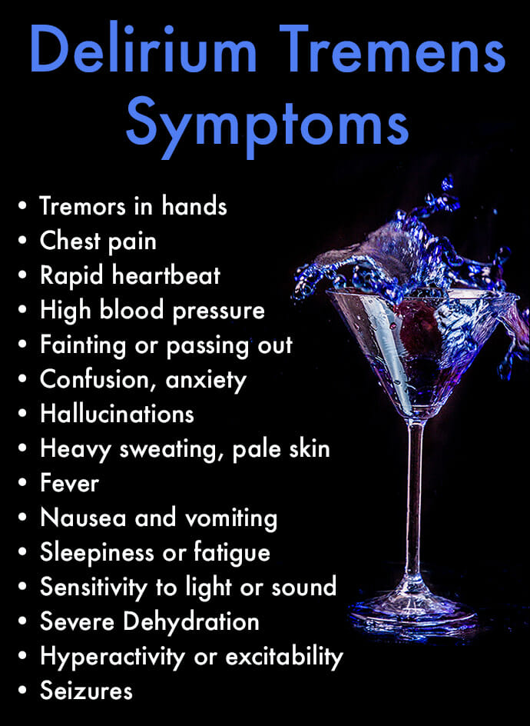
Alcohol Use Disorder (AUD) –
Alcohol Cessation
Withdrawal begins 10-12 hours after last drink
Delirium Tremens begin 24-48 hours
Untreated DTs can result in seizures, aspiration pneumonia, delirium, and death
5-15% mortality rate if untreated
Requires in-patient treatment
Benzos – abrupt withdrawal is dangerous, similar treatment to avoid seizures and death

Slide 36
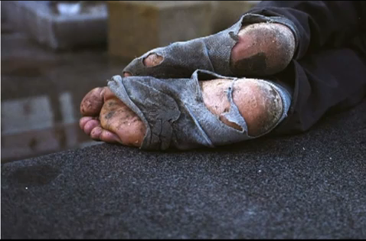
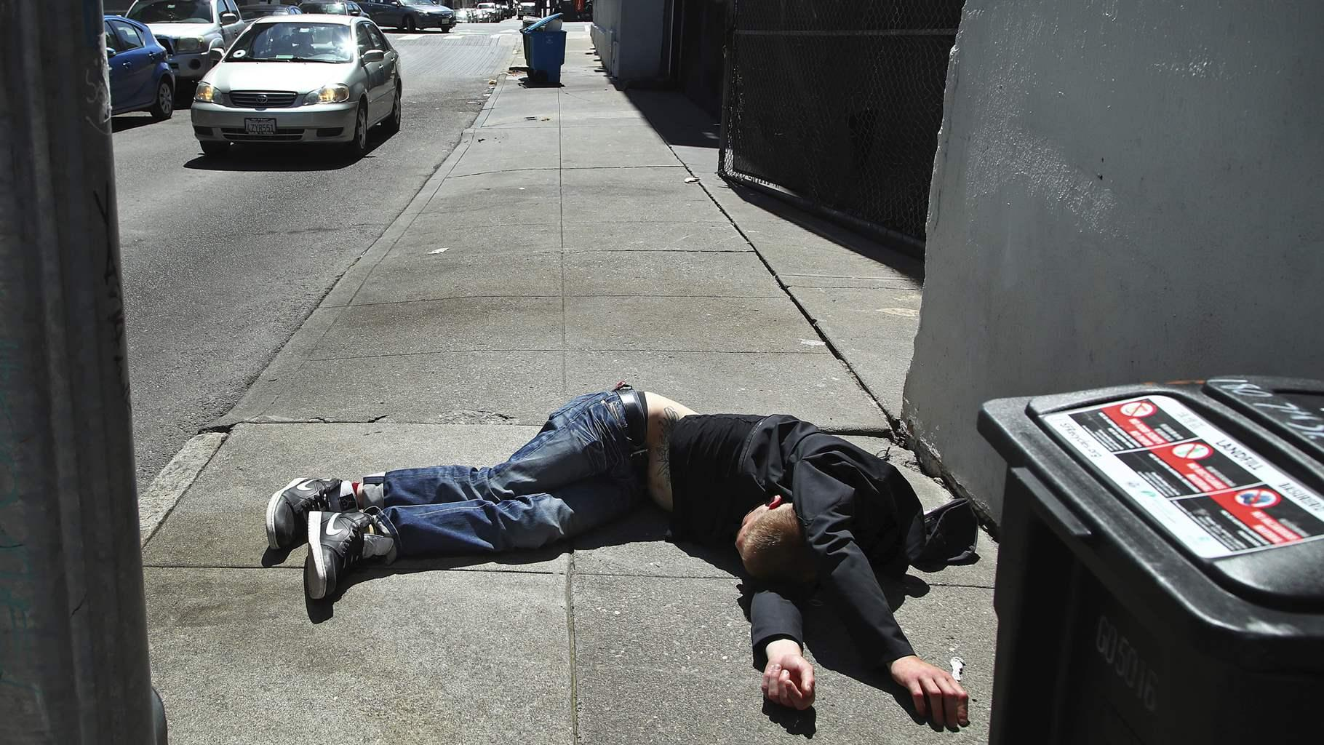
Substance Use Disorder - Heat

Slide 37
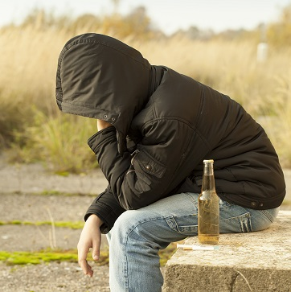
Substance Use Disorder (SUD) –
Medical Concerns
Screening/testing:
  HIV / Hep C screening (if injecting / sexual exposure)
  Screening for other mental health conditions
  Liver disease in those with significant alcohol use
Treatment:
  Reduce barriers to care
  Burns – wound care
  Injectors – skin abscesses, wound care
  In-patient rehab especially alcohol or benzo use
Preventative care:
  Harm reduction – needles, PreP
  Vaccines: Hep A, flu, COVID

Slide 38
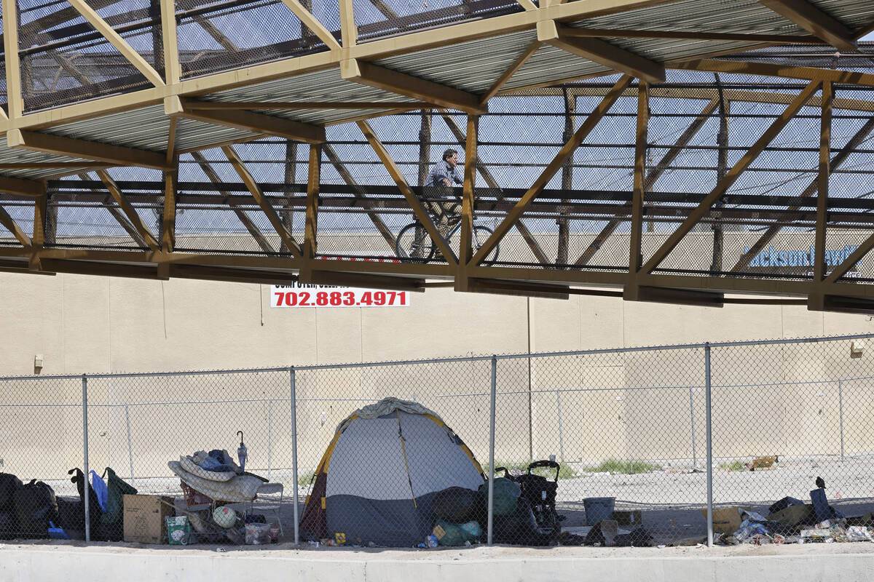
Immigrants - Statistics
Immigrants may not have childhood screening and vaccinations
Immigrants vs. refugees
May be unable to access resources due to immigration status
Often in dangerous conditions:
  Work – no OSHA Exposure to chemicals, dangerous environments
  Living – camps, housing conditions

Slide 39
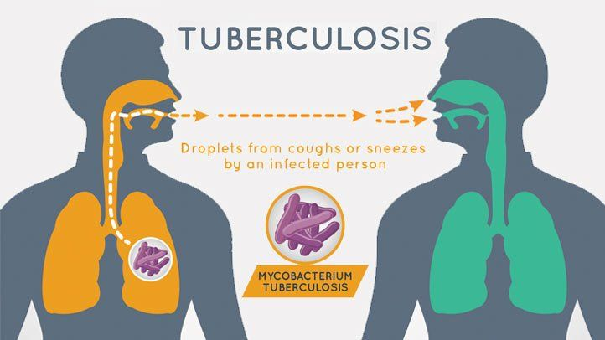
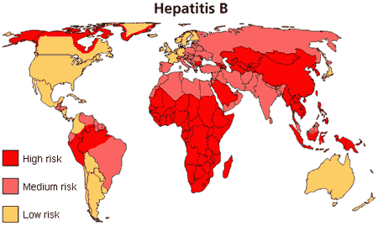
Immigrants – Medical Concerns
Tuberculosis – active vs. latent TB, 1:10 of latent become active
  High in homeless populations
  Even higher in immigrant populations from endemic countries
Hepatitis B – more likely to have CHB if from endemic countries
  Central America, Asia, Africa, Middle East
  Vertical transmission is common, and may not get vaccinated

Slide 40
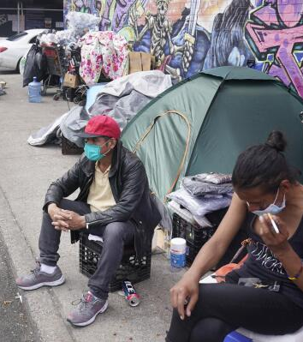
Immigrants – Medical Concerns
Screening/testing:
  TB screening if available
  Infectious disease
Treatment:
  If uninsured, free resources to avoid hospitalization
  In language assistance
Preventative care:
  Vaccinations including Tetanus

Slide 41

Summary
Consider intersectionality in your approach to PEH
Medical care should be different in different populations
Trauma informed care is important in all populations
Bring medical care to where people are
Promote preventative care in vulnerable people

Slide 42
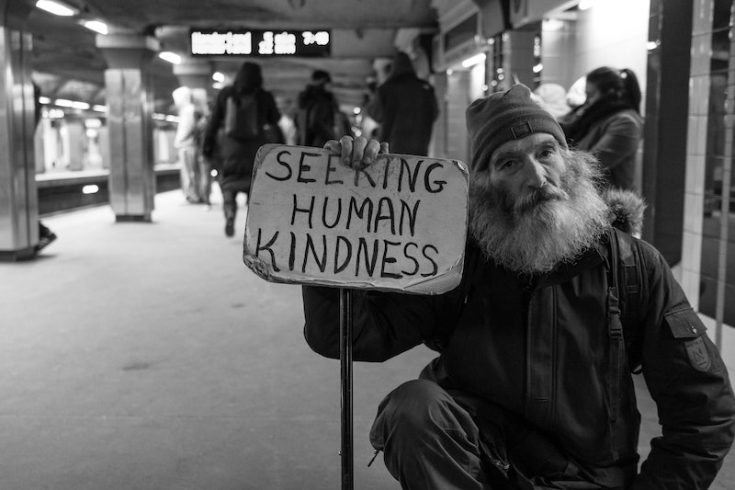

Slide 43

Case #1 – Woman in DV Shelter
25yo woman in with no PMH complains of GERD symptoms and insomnia. What medical considerations are there?
Screening:
Treatment:
Prevention:

Slide 44
Case #1 – Woman in DV Shelter
25yo woman in with no PMH complains of GERD symptoms and insomnia. What medical considerations are there?
Screening:
  Screen for depression, anxiety, PTSD
  Screen for trafficking
  Offer STI
Treatment:
  GERD – avoid triggers, medications
  Insomnia – sleep hygiene, treat the underlying condition
Prevention:
  Offer PreP and birth control

Slide 45
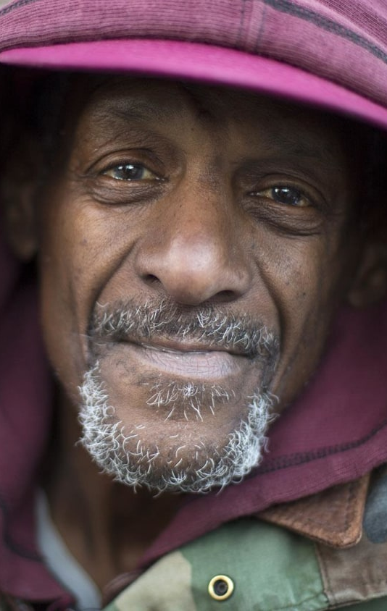
Case #2 – Senior Unsheltered
66yo man with PMH DM, HTN presents today for “screening”. Blood pressure 178/90 “that’s normal for me” and BG 367 “I just drank a Gatorade). What medical considerations are there?
Screening:
Treatment:
Prevention:

Slide 46
Case #2 – Senior Unsheltered
66yo man with PMH DM, HTN presents today for “screening”. Blood pressure 178/90 “that’s normal for me” and BG 367 “I just drank a Gatorade). What medical considerations are there?
Screening:
  Ask about vision, check feet, ask about chest pain / SOB
Treatment:
  BP and BG are elevated, discuss treatment goals, offer to adjust meds
  Refer to easily accessible medical clinic for labs
Prevention:
  Discuss diet (avoid juice, soda, Gatorade)
  Offer vaccines (COVID, high dose flu, pneumonia, shingles, etc.)
  Harm reduction (tobacco cessation, good shoes/socks)

Slide 47


Case #3 - SUD / SMI
35yo man sleeping at The Courtyard (unsheltered) has sores on his calf. He admits to smoking “sherm sticks” in order to avoid hearing the voices. What medical considerations are there?
Screening:
Treatment:
Prevention:

Slide 48
Case #3 - SUD / SMI
35yo man sleeping at The Courtyard (unsheltered) has sores on his calf. He admits to smoking “sherm sticks” in order to avoid hearing the voices. What medical considerations are there?
Screening:
  Voices – could be SMI or result of substances
  Screen for SI / HI
  Ask about sores – rest of body, IVDU?
Treatment:
  Assess readiness for help
Prevention:
  Very likely to experience a crisis without desire to get better and a medical mental health home

Slide 49

Case #4 – Immigrant from Columbia
35yo male, undocumented immigrant from Columbia x 2 months, experiencing homelessness. Was being treated in Columbia for HIV. What medical considerations are there?
Screening:
Treatment:
Prevention:

Slide 50
Case #4 – Immigrant from Columbia
35yo male, undocumented immigrant from Columbia x 2 months, experiencing homelessness. Was being treated in Columbia for HIV. What medical considerations are there?
Screening:
  In-language counseling
  Offer screening for other STIs / Hep B/C / TB
  Depression / SI
Treatment:
  Refer directly to a treatment center, then and there
Prevention:
  PreP, risk reduction

Slide 51

Case #5 – Woman with SOB
30yo woman with history of multiple food allergies presents in The Courtyard with significant SOB. Leaning forward, appears distressed, spitting out saliva on the pavement, appears to be in distress. What medical considerations are there?
Screening:
Treatment:
Prevention:

Slide 52
Case #5 – Woman with SOB
30yo AA woman with history of multiple food allergies presents in The Courtyard with significant SOB. Leaning forward, appears distressed, spitting out saliva on the pavement, appears to be in distress. What medical considerations are there?
Screening:
  Read the room – this isn’t the time and place
Treatment:
  Urgently needs medical intervention
Prevention:
  Don’t leave the hospital without an Epi pen script

Slide 53
Contact Information
Rebecca Edgeworth, MD
redgewor@touro.edu
Mayra Gonzalez, CHW
mgonzale34@touro.edu
Touro University Nevada
https://tun.touro.edu/

Slide 54
References
https://endhomelessness.org/homelessness-in-america/homelessness-statistics/state-of-homelessness/
https://www.americashealthrankings.org/explore/measures/PCP_NPPES
https://endhomelessness.org/blog/recognizing-women-experiencing-homelessness-a-womens-history-month-spotlight-on-downtown-womens-center/
https://www.ncbi.nlm.nih.gov/pmc/articles/PMC4833089/
Adverse Childhood Experiences (ACEs) | VitalSigns | CDC

