Slide 1
Current Trends in Drugs of Abuse
Kelly Swan, she/her
kellys@RITETrainings.org
Copyright 2023 RITE Training; all rights reserved.

Slide 2
Today
Substance Use & Homelessness
Alcohol
Marijuana
Opioids
Hallucinogens
Stash Clothing

Slide 3
HUD PIT 2022 HOMELESS IN US & TERRITORIES
Total persons – 582,482
Chronic Substance Abusers - 95,001 (16%)
Notes:
16 %

Slide 4
Substance Abuse and Homelessness
Nationally
20 to 40% of homeless persons have a substance abuse issue
In Nevada
Of the 74% of homeless who report a disabling condition, 36% report substance abuse
Substance abuse and homelessness are bi-directional
Chicken or the egg?
High ACEs scores
Notes:
The roots of substance use amongst individuals experiencing homelessness generally trace back to the presence of Adverse Childhood Experiences (ACEs) during the person’s childhood and adolescence. ACEs are traumatic or stressful events experienced or witnessed by a child, and may include such occurrences as abuse (physical, emotional, or sexual), neglect, domestic violence, poverty, substance misuse within the household, volatile parental relationships, or the death or incarceration of family members. ACEs lead to social, emotional, and cognitive impairments that may result in the adoption of high-risk behaviors that lead to disease, disability, and earlier deaths than individuals who did not experience ACEs.. A history of ACEs has been robustly associated in scientific literature with homelessness, mental illness, alcohol abuse, and drug abuse. The role of ACEs in driving substance use amongst people experiencing homelessness and untreated or undertreated mental illness cannot be overstated

Slide 5
Substance Abuse and Homelessness
Substance use may be viewed as necessary to be accepted on the street
Motivation to stop may be low
Without positive social support network, recovering from substance abuse is extremely difficult
Temptation – widely accessible substances in close proximity
Co-occurring trauma and/or mental illness and/or pain issues

Slide 6
Alcohol Trends

Slide 7
Alcohol & Homelessness
Cheap
Accessible
Legal
Effective for Self-Medicating
Addictive
May exacerbate underlying mental or physical health problems,
May create new physical health problems
Can be dangerous to discontinue
Tolerance builds

Slide 8
Alcohol and pregnancy
CDC study from 2018 - 2020
2022 Morbidity and Mortality Weekly Report
1 IN 7
Any alcohol use in past 30 days
1 IN 20
Binge drinking in the past 30 days

Slide 9
Excessive drinking is responsible for more than 3,900 deaths among people under age 21 each year 1 person dies in the U.S. every 45 minutes from a drunk driver
https://www.cdc.gov/alcohol/fact-sheets/
Notes:
Underage drinking is a significant public health problem in the U.S. Excessive drinking is responsible for more than 3,900 deaths and 225,000 years of potential life lost among people under age 21 each year.

Slide 10
Marijuana

Slide 11
A Changing Society
1990s – A New NORML
Legalization of Marijuana
Decriminalization - Alaska 1998
Medical use: Washington & Colorado 2012
First, a push for decriminalization
…then medical use
…then recreational use

Slide 12
A Changing Society
2023
27 states have partially or fully decriminalized some offenses for marijuana possession
Legal medical use:
37 states and the District of Columbia
4 U.S. territories
Legal recreational use:
19 states and the District of Columbia
2 U.S. territories
National Organization for the Reform of MJ Laws, www.NORML.org

Slide 13
Marijuana extracts
“BHO” - Hash oil or Honey oil a gooey liquid
Wax or Budder a soft solid with texture like lip balm
“DABS”
Shatter a hard, amber-colored solid

Slide 14
POTENCY
Marijuana extracts are
200-400 times the potency
of the marijuana of a few decades ago

Slide 15
Marijuana: Did you know?
Loss of coordination and slower reaction times, altered sense of time
Some people feel relaxed
Some people get feelings of anxiety, fear, distrust, even paranoia or panic
High doses of MJ cause faster heart rate by 20 to 50 beats on average, and elevated blood pressure
NIDA.gov

Slide 16
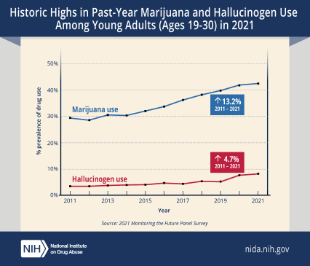
HISTORIC HIGHS IN MARIJUANA & HALLUCINOGEN USE (2021)
Notes:
According to the recent Monitoring the Future study results, Marijuana and hallucinogen use reported by persons 19 to 30 years old increased significantly in 2021 compared to five and 10 years ago, reaching historic highs in this age group not seen since 1988. Alcohol remains the most used substance among adults in the study, though past-year, past-month, and daily drinking have been decreasing over the past decade. Binge drinking (five or more drinks in a row in the past two weeks) rebounded in 2021 from a historic low in 2020, during the early stages of COVID-19 pandemic. And high-intensity drinking (having 10 or more drinks in a row in the past two weeks) has been steadily increasing over the past decade and in 2021 reached its highest level ever recorded since first measured in 2005

Slide 17
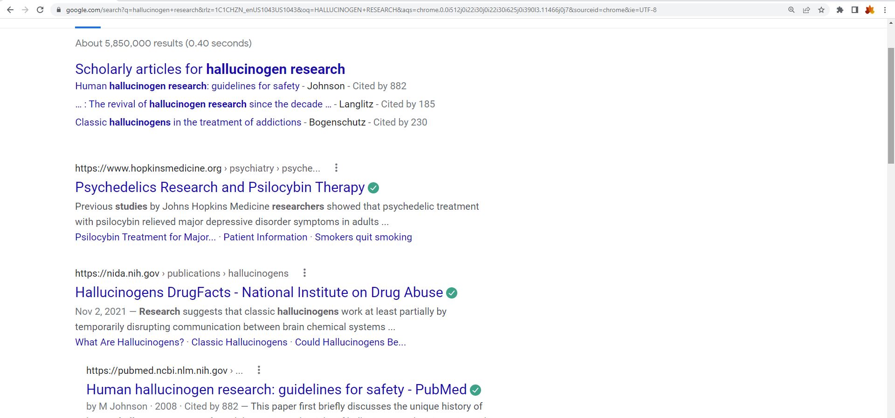
A Changing Society

Slide 18
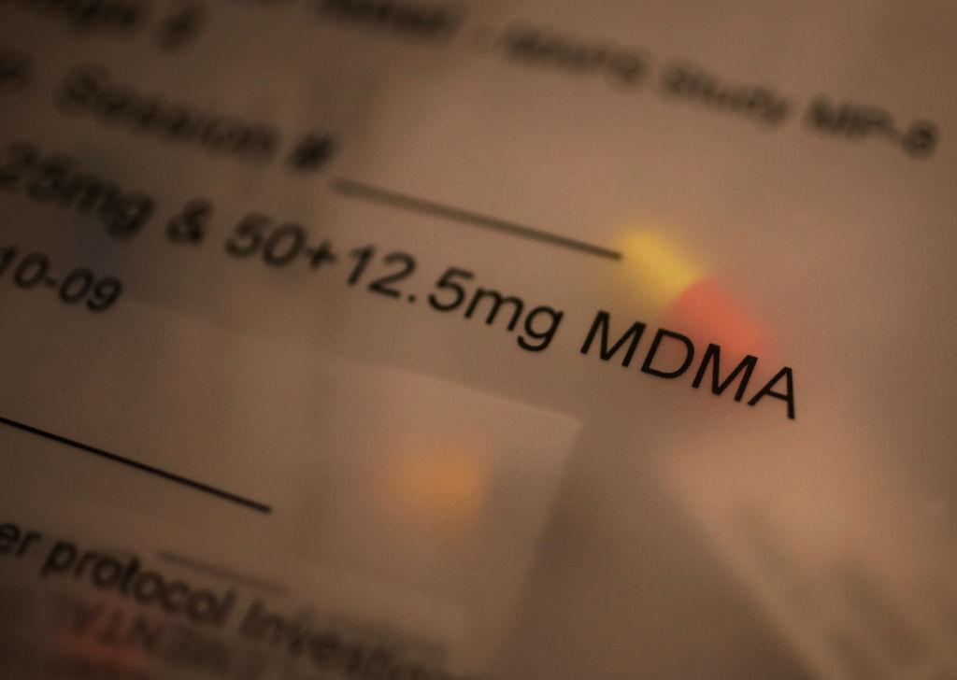
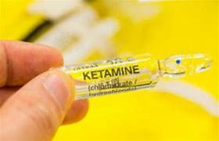
Legalities and FDA status
FDA has granted breakthrough status for MDMA & psylocibin which puts them on a fast-track for approval
2018 - Psylocibin for treatment-resistant depression, and fear of death in cancer patients
2019 - MDMA for PTSD
2019 - Ketamine (dissociative hallucinogen) for off-label applications such as depression, chronic pain, or psychiatric disorders.

Slide 19
A Changing Society
Psilocybin use became legal in Oregon 1/1/23
Colorado resident recently voted to do the same.
Legislation to legalize psilocybin has been introduced in other states including:
Connecticut
New Jersey
California
TIME Magazine, “Psychedelics May Be Part of U.S. Medicine Sooner Than You Think,” Feb. 8, 2023. https://time.com/6253702/psychedelics-psilocybin-mdma-legalization/

Slide 20
Opioids

Slide 21
Opioid Facts
1999 to 2018
Sale of opioids increased 400%
2012
259 million prescriptions for painkillers
Enough for EVERY American man, woman and child to have a bottle of pain pills
2015
Americans more likely to die from opioid death than a car accident
Notes:
From 1999 to 2018, amount of pain reported remained stable while sale of opioids increased 400%. In 2012, health care providers wrote 259 million prescriptions for painkillers. That’s was enough for EVERY American man, woman and child to have a bottle of pain pills
By 2015 you were more likely to die from opioid death than a car accident

Slide 22
Opioid Facts
From August 2021 to August 2022
107,735 Americans from drug poisonings
66 percent of those deaths involved synthetic opioids like fentanyl
The vast majority of the fentanyl that is being trafficked in communities across the US comes from the Sinaloa Cartel and Jalisco Cartel in Mexico, using chemicals largely sourced from China
Center for Disease Control, National Center for Health Statistics

Slide 23
Fentanyl
Not just another opioid…
Notes:
The fentanyl problem is directly related to the increase in marketing, the promotion in the 90’s of pain as the 5th vital sign, and vigorous narcotic prescribing practices that started at that time. It is also related to the fact that growing poppies and processing opiates takes considerable time and manpower, but mixing up chemicals in large quantities in a lab or bathtub is quick and not labor intensive. So, as a result of the opioid prescribing practices which a massive increase in narcotic dependence, international dealers starting producing large amounts of fentanyl and adding it to illegally made pills and to heroin. It’s cheap, doesn’t require a growing season, and highly potent. The problem with the influx of fentanyl into illegal drugs were the addictive potential of fentanyl is so much greater than heroin, and the potency is so high that accidental overdose deaths skyrocketed. At the same time, methadone prescriptions escalated like never before, with methadone being prescribed for chronic pain and not just for opioid replacement.

Slide 24
Fentanyl Facts
Fentanyl:
80 to 100 times more potent than morphine
50 times more potent than heroin
Illegal forms – pills, powder, nose spray, candy, eye drops
Opioid deaths with fentanyl detected
2010 - 14.3%
2017 - 59.8%
https://nida.nih.gov/publications/drugfacts/fentanyl
Notes:
Fentanyl is a powerful synthetic opioid that is similar to morphine but is 80 to 100 times more potent than morphine, and 50 times more potent than heroin.
In its prescription form it is prescribed for extreme pain or terminal illnesses, but fentanyl is also made illegally.
Fentanyl and other man-made opioids are the most common drugs involved in overdose deaths.
Illegal fentanyl is sold in the following forms: as a powder, dropped on blotter paper, small candy look-alikes, eye drops, nasal sprays, or made into pills that look like real prescription medications but are exponentially more potent.
You can trace the rise in illegally produced fentanyl by looking at our overdose stats. For example, 14.3 percent in 2010 involved fentanyl compared to 59.8 percent of opioid-related deaths in 2017

Slide 25
Now… Xylazine (Tranq)
DEA Reports Widespread Threat of Fentanyl Mixed with Xylazine
“Xylazine is making the deadliest drug threat our country has ever faced, fentanyl, even deadlier,” said Administrator Milgram. “DEA has seized xylazine and fentanyl mixtures in 48 of 50 States. The DEA Laboratory System is reporting that in 2022 approximately 23% of fentanyl powder and 7% of fentanyl pills seized by the DEA contained xylazine.”
Drug Enforcement Agency, Dec. 2022, https://www.dea.gov/alert/dea-reports-widespread-threat-fentanyl-mixed-xylazine
Notes:
In Dec. 2022 the DEA put out a rare Public Alert about a new drug of abuse: Xylazine, street name “Tranq” “Xylazine is making the deadliest drug threat our country has ever faced, fentanyl, even deadlier,” said Administrator Milgram. “DEA has seized xylazine and fentanyl mixtures in 48 of 50 States. The DEA Laboratory System is reporting that in 2022 approximately 23% of fentanyl powder and 7% of fentanyl pills seized by the DEA contained xylazine

Slide 26
Xylazine (Tranq)
Xylazine and fentanyl drug mixtures place users at a higher risk of suffering a fatal drug overdose
Xylazine is not an opioid, naloxone (Narcan) does not reverse its effects
When injected, xylazine can cause severe wounds, including necrosis that may lead to amputation
Drug Enforcement Agency, Dec. 2022, https://www.dea.gov/alert/dea-reports-widespread-threat-fentanyl-mixed-xylazine
Notes:
Xylazine and fentanyl drug mixtures place users at a higher risk of suffering a fatal drug poisoning. Because xylazine is not an opioid, naloxone (Narcan) does not reverse its effects. Still, experts always recommend administering naloxone if someone might be suffering a drug poisoning. People who inject drug mixtures containing xylazine also can develop severe wounds, including necrosis—the rotting of human tissue—that may lead to amputation.

Slide 27
WHAT DO YOU KNOW ABOUT STASH CLOTHING?
D
Notes:
Stash clothing isn’t new, but it’s gone to a new level. There are some global brands that bring in a LOT of money and encourage drug use. The kids know about them, so we need to be aware of them, too.

Slide 28
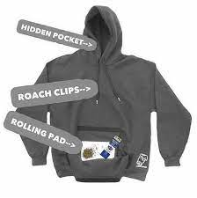
STASH CLOTHING
Rolla Wear brand
Notes:
The Rolla Wear brand has a hoodie that features a hidden hood pocket for drug stash, the string has roach clip ends, and there is a built in rolling board in its front pocket for rolling joints

Slide 29
STASH CLOTHING
Eagle Creek
Undercover Stash Bra
Notes:
Eagle Creek mass-produces an undercover stash bra. The bra has a hidden pocket that can be used as a drug pocket

Slide 30
STASH CLOTHING
Speakeasy Briefs
Notes:
Speakeasy Briefs is a brand that mass-produces briefs that feature a hidden compartment on the crotch. Youth can easily use it to stash drugs, alcohol or paraphernalia.

Slide 31
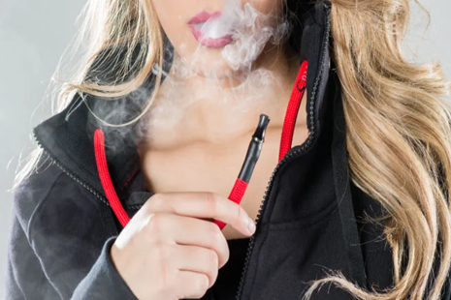
STASH CLOTHING
Vaprwear hoodies
Notes:
Vaprwear manufactures hoodies that connect to vape cartridges so youth can vape through the hoodie’s drawstring

Slide 32
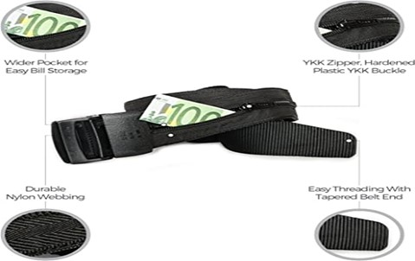
STASH CLOTHING
Zero Grid belts
Notes:
Dailyshoes manufactures a range of boots with large front pockets. Most wearers use the compartments to hide contraband and .
Zero grid sells belts that have hidden pockets which are used to hide drugs and drug money

Slide 33
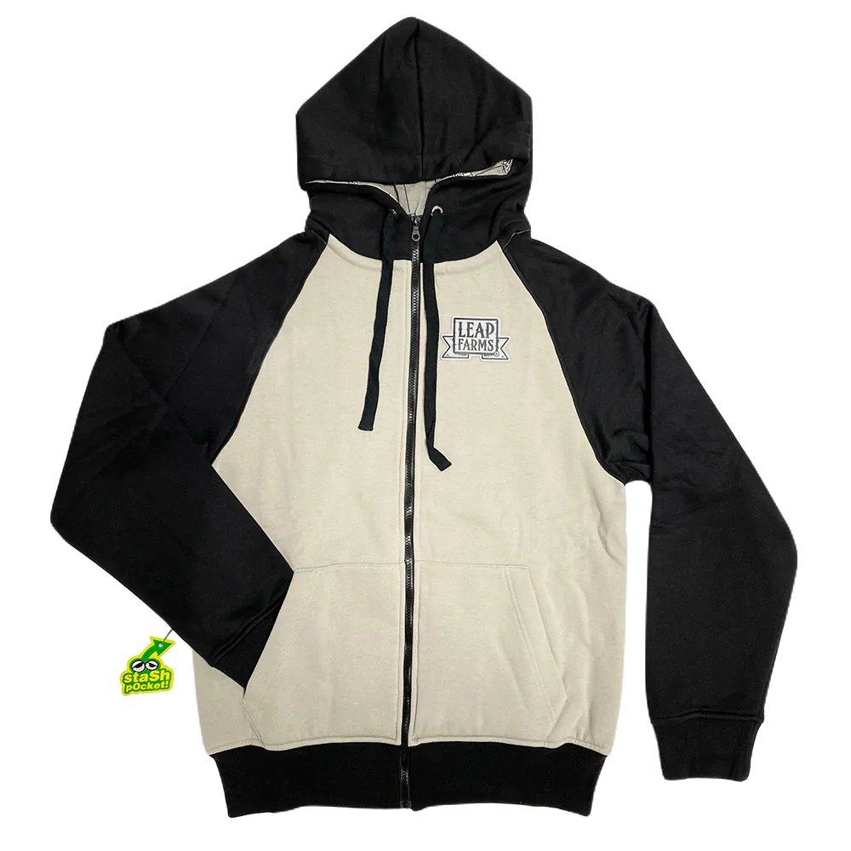
STASH CLOTHING
Seedless Clothing – Designer Cannabis Shirts & Tees / 420 Clothes
https://seedlessclothing.com
Since 1992, Seedless Clothing is a clothing brand that offers cannabis clothing like tees, hoodies, hats, masks and also serves cannabis art print stickers, rolling trays, and backpacks. Shop Now!
TEES
Shop high-quality cannabis shirts, tees, and apparel with unique designs Hats
Shop high-quality seedless hats, snapbacks, dad hats, and custom hats Hoodys
Shop Weed Hoodies & Sweatshirts from talented designers
Stickers
Shop unique cannabis stickers pack created by an artist.
ART PRINTS
Shop high-quality printed cannabis posters created by an artist.
ACCESSORIES
Shop cannabis accessories like socks, rolling trays, pin, belt, lanyard, and many …
Backpacks
Backpacks - Seedless Clothing - Designer Cannabis Shirts & Tees | 420 Clothing
Notes:
Seedless Clothing is a large manufacturer sold in most malls at Spencers and Hot Topic. Please notice the stash pocket. Their hoodies, backpacks and hats are very popular.

Slide 34
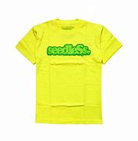
STASH CLOTHING – seedleSs
Logo
Notes:
Here is the seedless logo and their spelling with a small “s” at the beginning and a cap “S” toward the end. Notice the logo on the hat. It’s obvious, but on some products it’s more hidden. Also, here is the stash pocket on this particular hat.

Slide 35
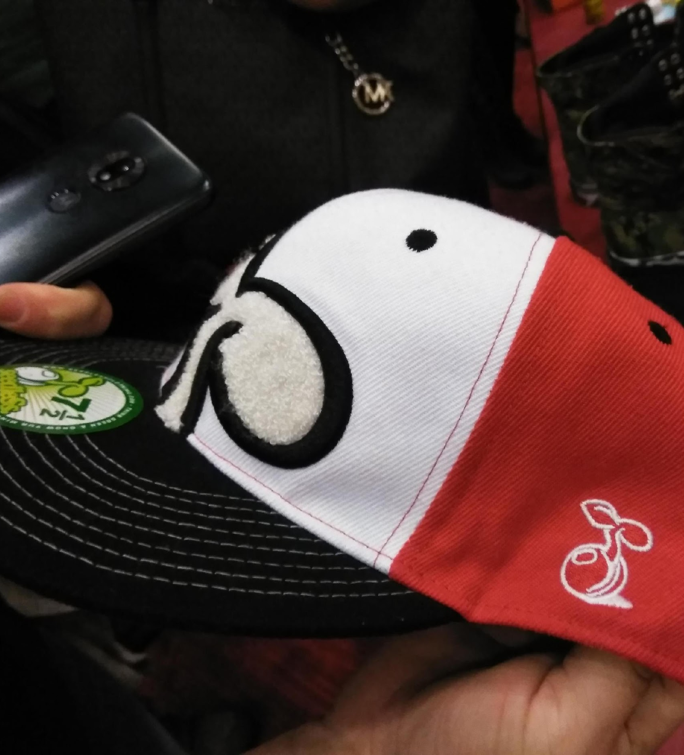
seedleSs

Slide 36
Under logo stash pocket

Slide 37
SUMMARY
Social norms and drug laws continue to change
Accessibility and potency have increased
Drugs of abuse follow trends and current trends include:
MJ & hallucinogen use are at historic highs for young adults
Prescriptive use of hallucinogens is on the horizon
“Stash clothing” has gone mainstream
Opioid overdoses are still climbing
Fentanyl is highly prevalent and extremely potent
Marijuana extracts are 200-400 times the potency of MJ of a few decades ago
Xylazine (“Tranq”) has been documented in 48 of 50 states
Xylazine contamination is rising and causing severe health problems and deaths

Slide 38
RELIABLE RESOURCES The Center for Disease Control and Prevention (CDC) Substance Abuse & Mental Health Services Administration (SAMHSA) National Institute on Drug Abuse (NIDA) National Alliance to End Homelessness (NAEH) United States Interagency Council on Homelessness (USICH)

Slide 39
Q & A
www.RITETrainings
YouTube: #RITETrainings
info@RITETrainings.org
kellys@RITETrainings.org
Copyright RITE Training. All rights reserved.
Notes:
We hope you’ve gained useful knowledge in this training on Current Trends in Drugs of Abuse. For more educational videos, please visit our website at www.RITETrainings.org, view our short reels on YouTube channel #RITETrainings, or contact use at info@RITETrainings.org

